Slide 1

NARFE REGION X PRESIDENTS’ CONFERENCE
Corbin, Kentucky
Gaston Gianni
VFC PR Chair
August 2, 2011
NARFE:CHALLENGED AS NEVER BEFORE
NARFE:CHALLENGED AS NEVER BEFORE

Slide 2
HOW TO MARKET NARFE
NARFE:CHALLENGED AS NEVER BEFORE

Slide 3
Why is it necessary, who should do it and how?
Are Marketing and Public Relations the same?
NARFE:CHALLENGED AS NEVER BEFORE

Slide 4
Those organizations that have the most effective communications are those that don’t get hung up on what’s marketing and what’s public relations.
NARFE:CHALLENGED AS NEVER BEFORE

Slide 5
OVERVIEW
What is marketing/public relations?
Why is it Important?
Targeting Potential Members
VFC PR Goals
Where do we stand?
Matching Funds
What does PR look like?
Resources
Closing
NARFE:CHALLENGED AS NEVER BEFORE

Slide 6
Ww What is Public Relations?
"Public relations is the planned and sustained effort to establish and maintain goodwill and mutual understanding between an organization and its publics.“
Why is it necessary, who should do it and how?
Everything you do or say is public relations!
NARFE:CHALLENGED AS NEVER BEFORE

Slide 7
ADVANCING NARFE
ADVANCING NARFE’S MISSION IN THE PUBLIC
SPREADING AWARENESS
INCREASING MEMBERSHIP
ENHANCING COMMUNICATIONS
NARFE:CHALLENGED AS NEVER BEFORE

Slide 8
Targeting Potential Members
Annuitants
Kentucky --------- 32,845
North Carolina ----- 71,412
Tennessee --------- 45,342
Virginia ------------139,905
West Virginia --------17,228
Do we know where they are in our States?
NARFE:CHALLENGED AS NEVER BEFORE

Slide 9
Targeting Potential Members
Active Federal Employees
Kentucky --------- 26,523
North Carolina ----- 43,678
Tennessee --------- 10,502
Virginia ------------145,449
West Virginia --------16,287
Do we know where they work? How can we gain Access to Them?
NARFE:CHALLENGED AS NEVER BEFORE

Slide 10
Targeting Potential Members
US Postal Service Employees
Kentucky --------- 6,948
North Carolina ----- 15,212
Tennessee --------- 10,426
Virginia ------------14,835
West Virginia --------3,178
They work at your nearest Post Office
NARFE:CHALLENGED AS NEVER BEFORE

Slide 11
Target Market Relations
One approach for all does not accomplish results
Different approaches are needed for each group
Active Employees are in the Electronic Age
How is your Web Site?
How involved are your members in community affairs?
What Goodwill are we accomplishing and does any one know about it?
NARFE:CHALLENGED AS NEVER BEFORE

Slide 12
VFC Public Relations Goals
Establish Communications Network with Chapter PR Chairs
Identify Best Practices in other Federations
Increase Use of Matching Funds
Assist Chapters PR Chairs
Determine where potential members live or work
Develop Strategic plan
Review Web Site Content
NARFE:CHALLENGED AS NEVER BEFORE

Slide 13
WHERE DOES VFC STAND?
60 NARFE Chapters in VFC
40 Chapters have PR Chairs
34 PR Chairs have listed email addresses
More Work Needed on Network
Developing a Strategic plan
NARFE:CHALLENGED AS NEVER BEFORE

Slide 14
MATCHING FUNDS
2010-2011 Projects—11
Total Cost of Projects $13,419
NARFE HQ--$6,507
VFC --$3,859
Chapters--$3,053
Project Range--$100-$5000
NARFE:CHALLENGED AS NEVER BEFORE

Slide 15
TYPES of PROJECTS
Booths at Fairs/ EXPOs
Tables at Postmasters Conventions
Pre-Retirement Seminars
Parade Float
Various Newspaper Ads
Recruiting Picnic
NARFE:CHALLENGED AS NEVER BEFORE

Slide 16
  WHAT DOES PR LOOK LIKE?
NARFE:CHALLENGED AS NEVER BEFORE

Slide 17
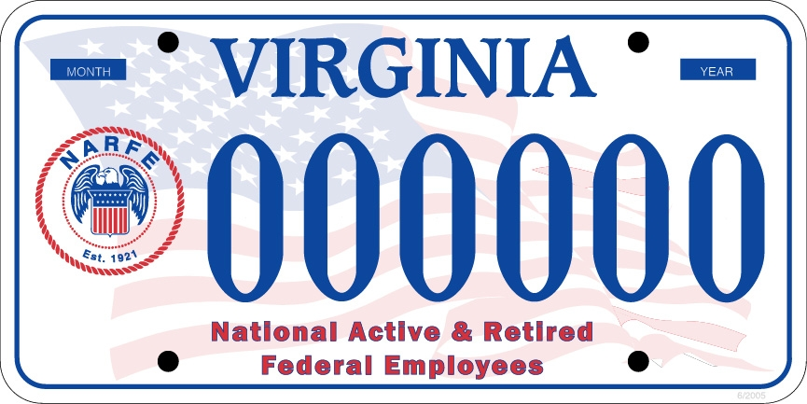
LICENSE PLATE PROJECT
NARFE:CHALLENGED AS NEVER BEFORE

Slide 18
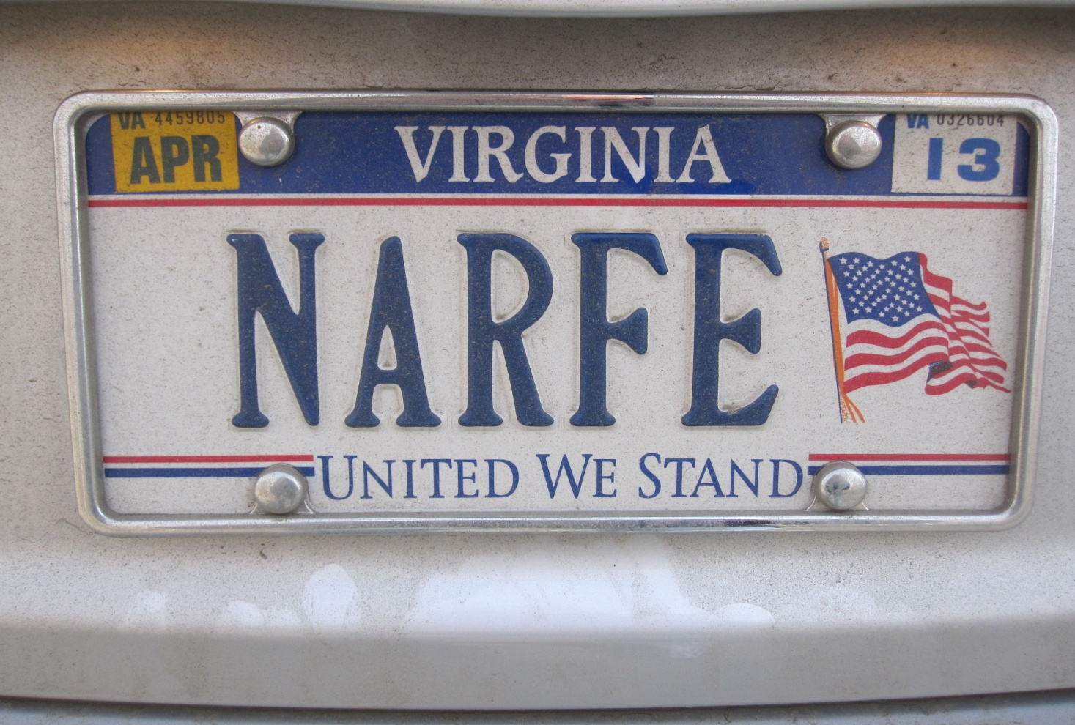
Other Plates
NARFE:CHALLENGED AS NEVER BEFORE

Slide 19
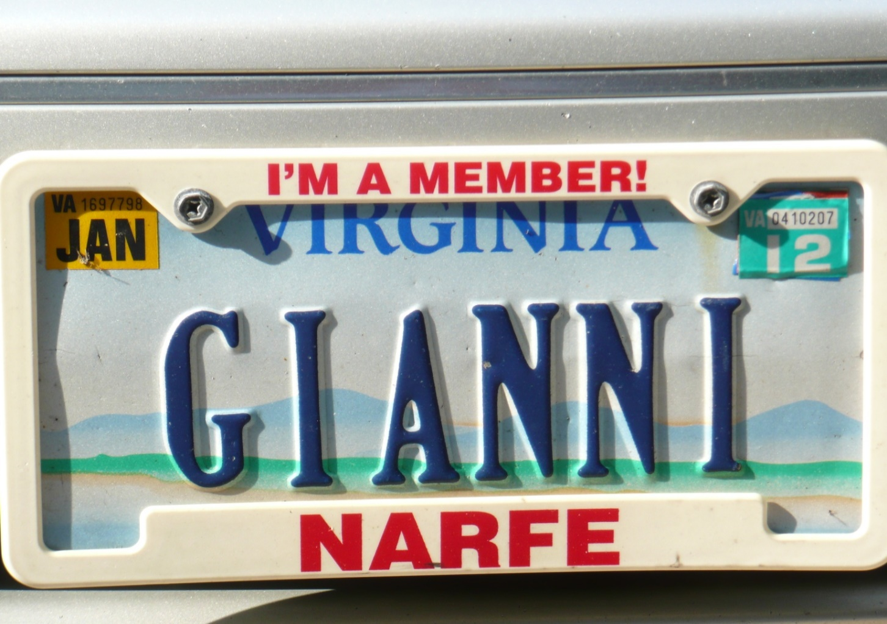
NARFE:CHALLENGED AS NEVER BEFORE

Slide 20
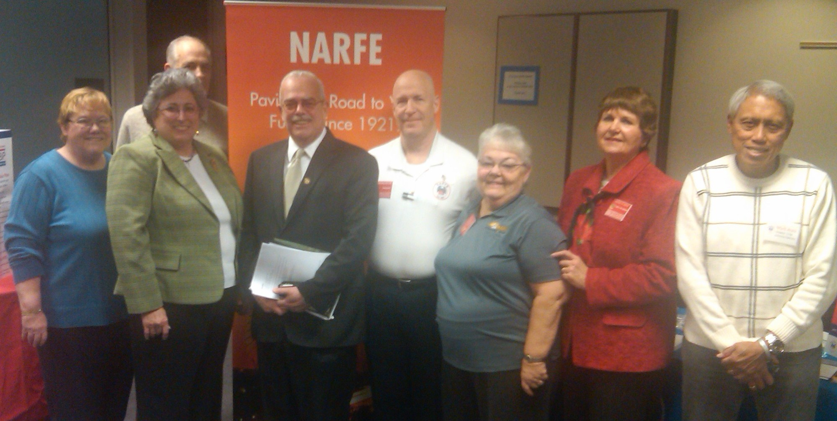
PUBLIC AWARENESS
Health Fairs
NARFE:CHALLENGED AS NEVER BEFORE

Slide 21
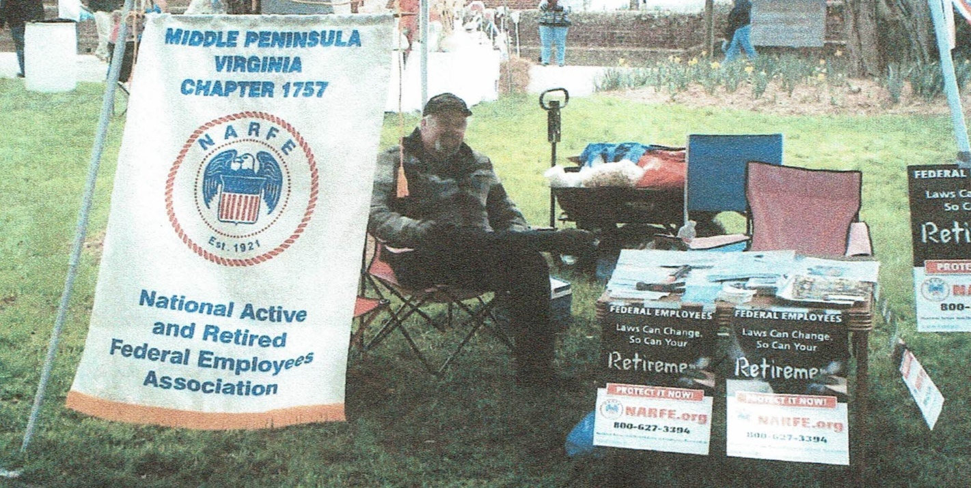
Recruiting at Daffodil Festival
NARFE:CHALLENGED AS NEVER BEFORE

Slide 22
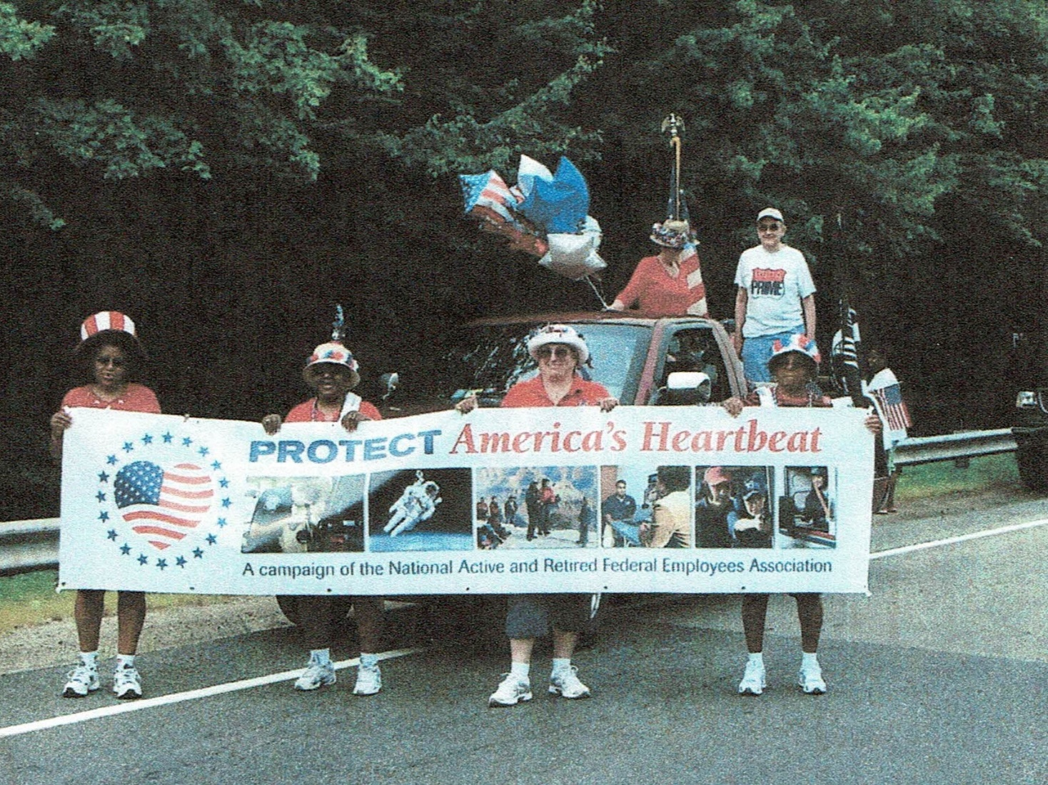
Protect America’s Heartbeat
NARFE:CHALLENGED AS NEVER BEFORE

Slide 23
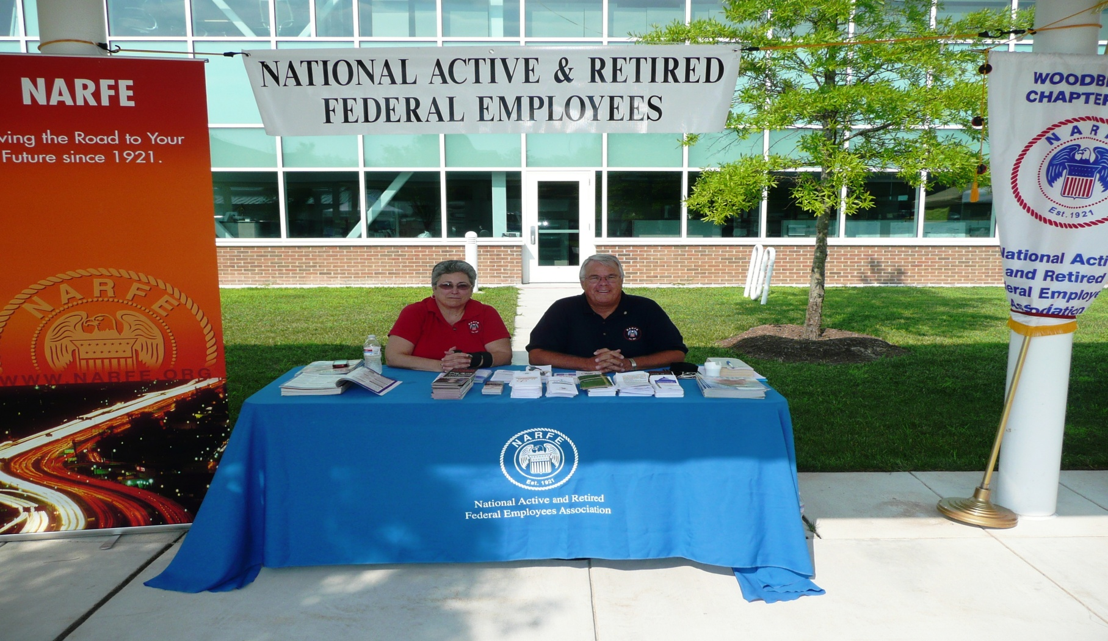
PWC FIRST NIGHT EVENT
NARFE:CHALLENGED AS NEVER BEFORE

Slide 24
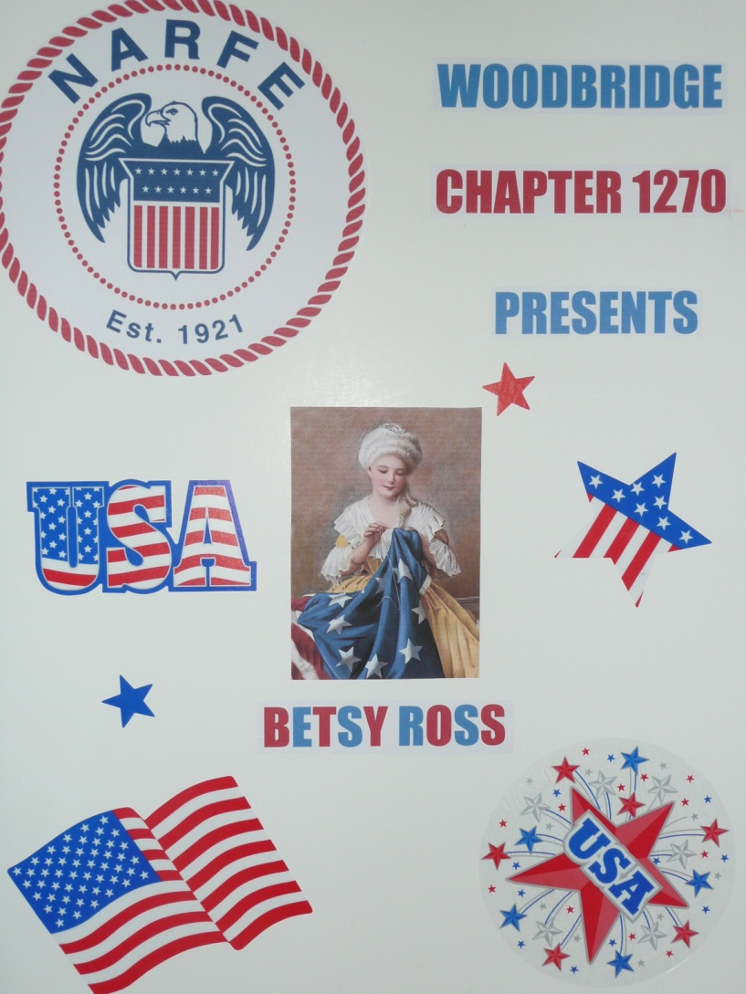
4th of July Parade
NARFE:CHALLENGED AS NEVER BEFORE
Notes:
4th

Slide 25
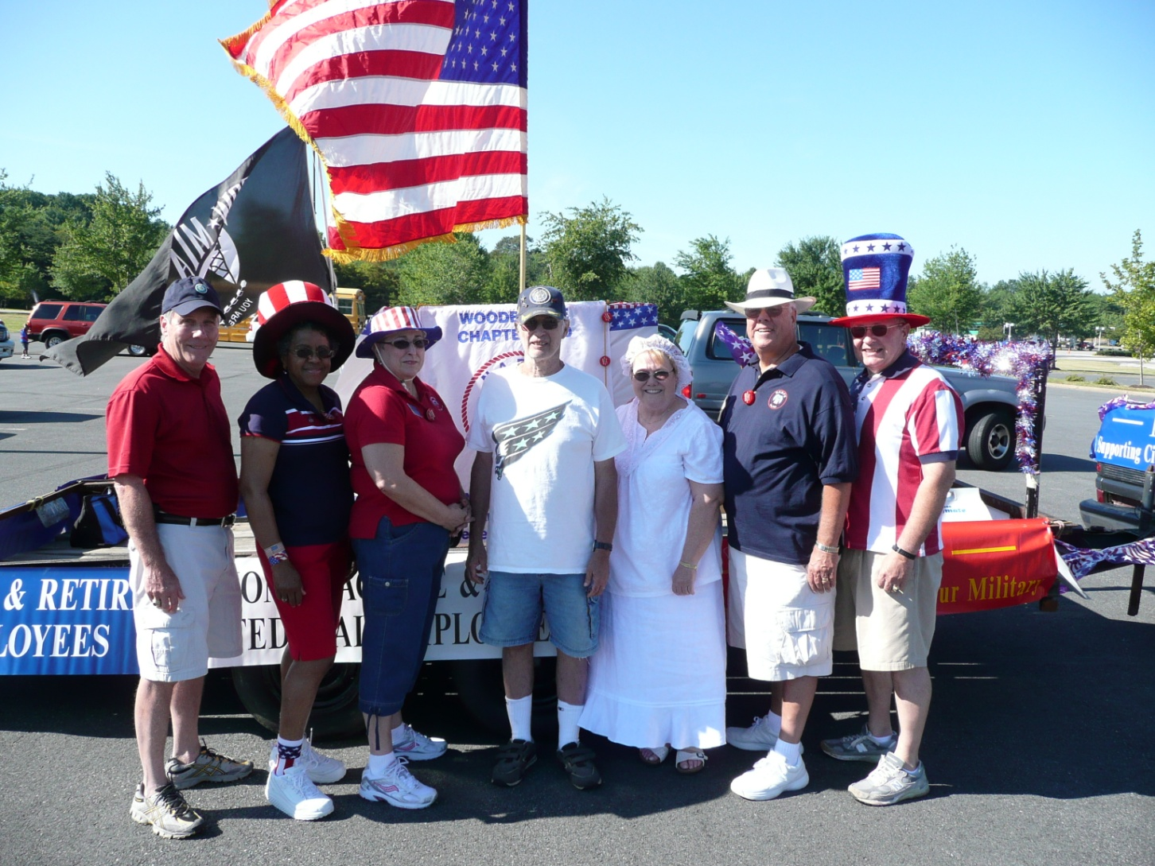
Ready to March!
NARFE:CHALLENGED AS NEVER BEFORE

Slide 26
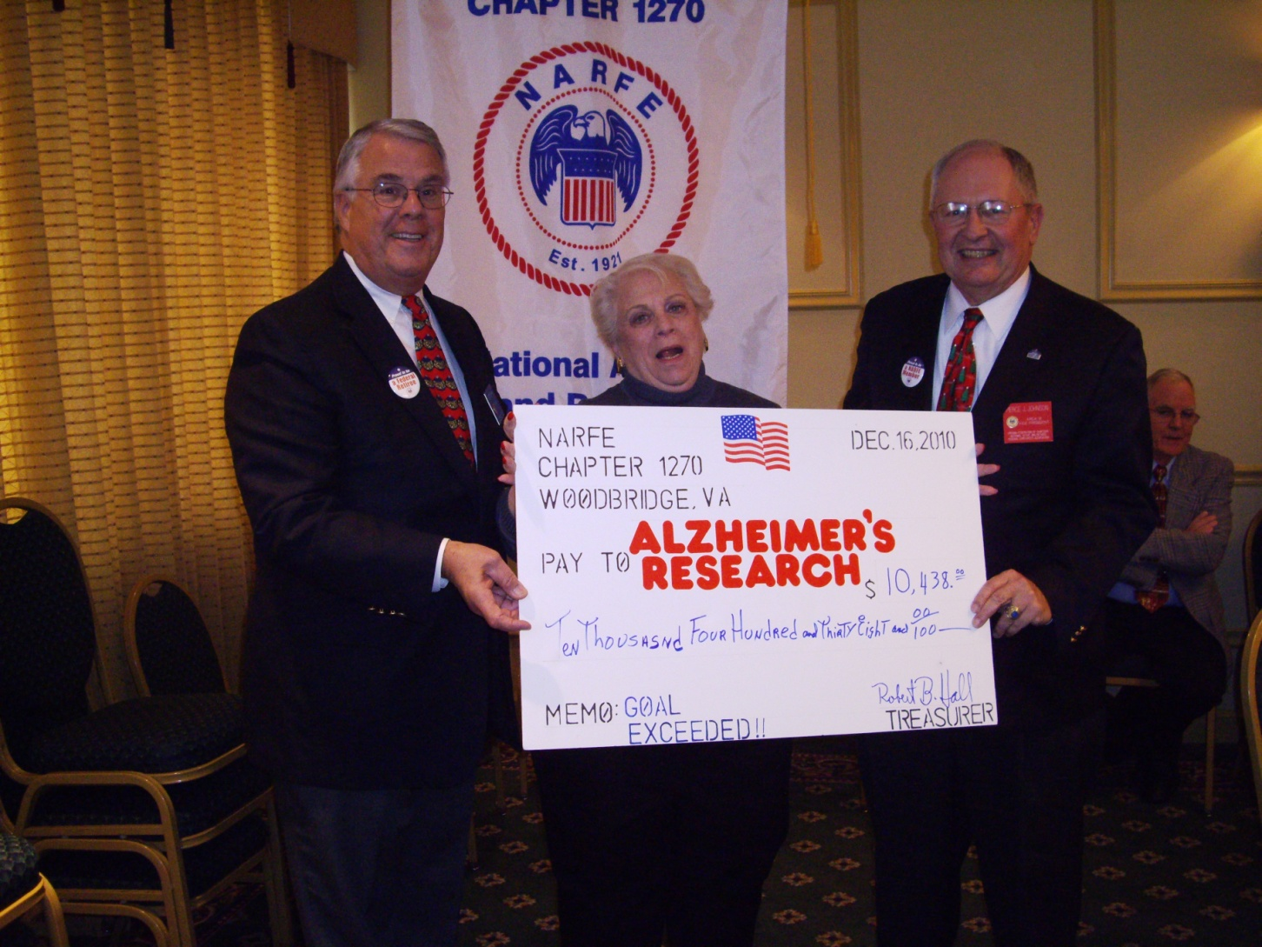
Chapter Events in
Local Papers
NARFE:CHALLENGED AS NEVER BEFORE

Slide 27

NEWSPAPER ADS
NARFE:CHALLENGED AS NEVER BEFORE

Slide 28
NARFE:CHALLENGED AS NEVER BEFORE

Slide 29
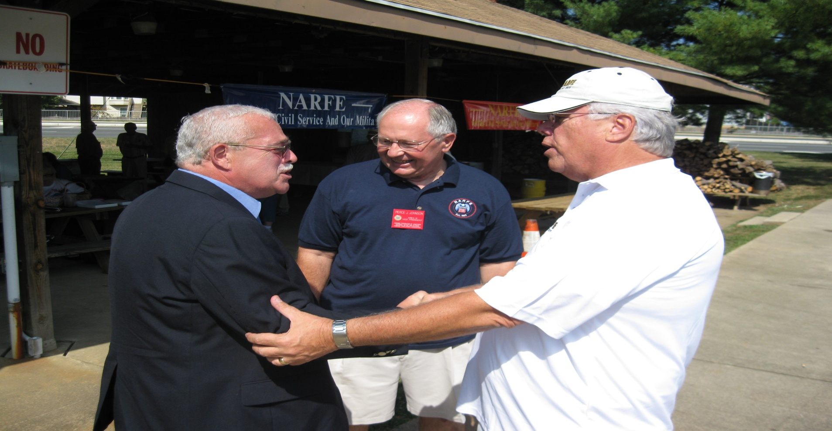
Invite Political Leaders
To Chapter Events
NARFE:CHALLENGED AS NEVER BEFORE

Slide 30
Letters to Local Papers
Letter to the Editor April, 16, 2011
NEWS and Messenger
Defending Federal Employees
There’s a new attack in Congress on federal workers and I urge the members of the Virginia delegation to rise above it. As a retired federal employee and a proud American, I am against a proposed bill (S. 644) that would eliminate pensions for all new government hires.
The purpose of this bill is not to save Americans money. This pension program is already paid for largely by federal employees themselves.
The real motive is to keep chipping away at the public image of federal employees. How quickly we forget that federal workers ensure our most basic needs as a society are met – from the safety of the food we eat to the quality of the air we breathe.
Right now, U.S. federal employees are helping Japan recover from disaster as our experts work on the ground to contain the damage of the nuclear power plant catastrophe.
There are over 145, 000 federal employees in Virginia. Changes to policies that affect federal employees in our state also threaten the future of the vital services they perform. Without competitive employment packages that match the value the services performed by our federal workforce, our government will struggle to attract the best workers to protect us.
When it comes to protecting Virginians we must not settle for second-tier government personnel. And I hope Senators Warner and Webb agree.
Gaston Gianni, Retired
Former Inspector General
Federal Deposit Insurance Corporation
NARFE:CHALLENGED AS NEVER BEFORE

Slide 31
RESOURCES
NARFE Public Relations Handbook
FH-9 (12/10)
Web Sites: www.narfe.org
www.vanarfe.org
Protect America’s Heartbeat Tool Kit
VFC PR Handbook (Under Construction)
VFC PR Chair gastongianni@aol.com
703-508-4339
NARFE:CHALLENGED AS NEVER BEFORE

Slide 32
Closing Quote
Bill Gates
"If I was down to my last dollar, I'd spend it on public relations."
NARFE:CHALLENGED AS NEVER BEFORE

Slide 33
Closing Thoughts
The VFC way may not do it your way
Exchange of ideas and practices can be helpful
The old way may not be the right way for today
If NARFE is to survive and be effective we need more members
Marketing and PR can lead the way
Because MARKETING & PUBLIC RELATIONS are nothing but BS!!
NARFE:CHALLENGED AS NEVER BEFORE

Slide 34
Questions / Thoughts
Brilliant
STUFF!!!
NARFE:CHALLENGED AS NEVER BEFORE

