Slide 1
Region X Training Conference
September 12, 2013
Legislative Update
Jessica Klement
NARFE Legislative Director
Notes:
Give background on bio if none is given

Slide 2
Frozen, Furloughed and FED Up!

Slide 3
What has happened so far?

Slide 4
Changes to Pay and Retirement
Three-year federal employee pay freeze
Increase in retirement contributions for those hired on or after January 1, 2013
Sequestration and Furloughs
For a Grand Total of….
Notes:
Small victory on pay freeze – 27 MOCs switched their vote positively
Furloughs on April 21st at – EPA, OMB, Park Service and FAA
well, we saw what happened with FAA.
DOD furloughs started this week. One day a week (20%) cut through Sept.

Slide 5
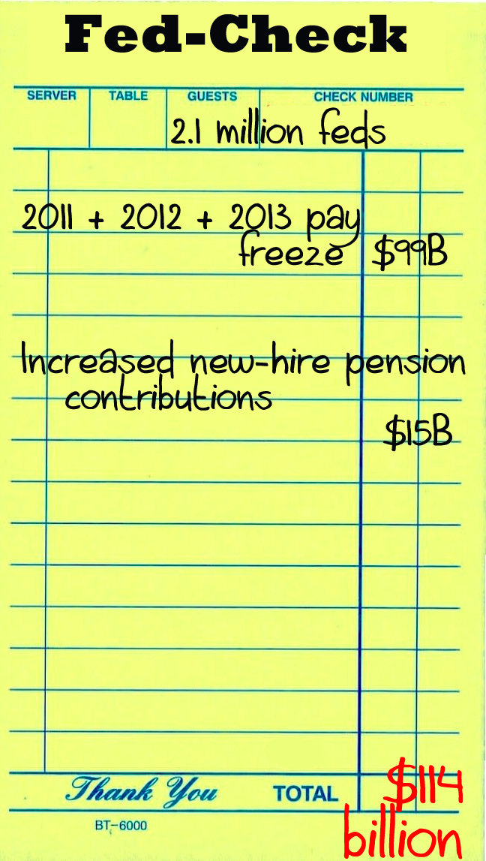
Changes to Pay
and Retirement
…$114 Billion!

Slide 6
What’s Still on the Table?
Notes:
So where does that leave us today?
You and I may think that $114 billion is enough, but not everyone agrees.
Unfortunately, many proposals that weren’t adopted in the 112th Congress are still on the table for the 113th.

Slide 7
What’s Still on the Table?
Chained CPI
A change in the way annual COLAs are computed to account for “behavioral adjustments,” such as when the cost of one good goes up, you will buy a different product
Takes from seniors and the most vulnerable in the name of deficit reduction
Not an accurate measure of seniors’ spending habits
Seniors are already typically buying the lowest priced goods
Amounts to a loss of .3% in COLAs each year
Over a 9% COLA reduction after 25 years, totaling $48,000 for the average CSRS annuitant
Notes:
Give short explanation
Does not reflect how seniors spend their money – Medical costs. Can’t switch medication easily
Mention Calculator
Change in tax code

Slide 8
What’s Still on the Table?
FEHBP reform
OPM proposals
Self plus one
Regional PPOs
Premium differentials tied to wellness
Domestic partner benefits (may be moot at this point)
Direct contracting on prescription drugs
Chairman Issa package (nothing released yet)
Possible changes as part of postal reform
Camp bill to remove feds from FEHBP and place them in the state exchanges created under the ACA
Notes:
In Pres’ budget for first time
Postal changes – Senate bill impacts all FEHBP participants.
Camp bill unlikely to move, but expect a lot of rhetoric

Slide 9
What’s Still on the Table?
Other Possibilities…
Increasing retirement contributions for current employees
Eliminating the FERS annuity supplement
Dangerous FECA reform
Continuing the pay freeze
High-3 to High-5
Postal Reform
Notes:
Important to note that these things haven’t happened b/c of NARFE advocacy!

Slide 10
So Now What?
Sequestration effects starting to be felt, but blame game continues
Government will be funded at sequestration levels for next 9 years, unless Congress takes action
Grand Bargain
Notes:
Gearing up for a very busy September and October.
What will FY14 look like?

Slide 11
So Now What?
September and October Deadlines
Fiscal year starts October 1
Likely a CR will pass instead of individual bills
Could mean more furloughs, possibly RIFs
Debt ceiling needs to be raised
Full repeal of Affordable Care Act top priority for House GOP
Grand Bargain
Could include federal funding, tax reform AND entitlement spending, including Chained CPI
Conversations taking place behind the scenes
Notes:
Not sure at this point what’s going to happen.

Slide 12
Protect America’s Heartbeat
www.protectamericasheartbeat.org
Notes:
So what can NARFE members do about it? That’s where the Protect America’s Heartbeat campaign comes in. Need to do more
Two components to the PAH campaign – media and grassroots
It’s important to keep in mind that PAH is not a campaign with a start and end date. This is an ongoing part of NARFE’s legislative activities

Slide 13
PAH Grassroots Campaign
WHAT?
A grassroots campaign designed to get NARFE members more engaged in legislation that affects them
WHO?
You!
WHY?
Because Congress can change your benefits AT ANY TIME
WHERE?
In your home states and districts, at NARFE chapter meetings
WHEN?
NOW!
Notes:
What is Grassroots?
A bottom up, not a top down, approach to advocacy
A locally driven, grassroots campaign shows momentum for an issue
Grassroots engagement shows personal commitment and demonstrates the importance of the issue – the more important it is to you, the more important it will be to your MOC.
Who Can Do Grassroots?
Everybody and Anybody
Does not require special skills or tools – don’t need a computer
Its just you telling your story… Who else better to do that then you? SHARE YOUR STORY WITH NARFE TOO! (mention questionnaire)
When Can I Do Grassroots?
August is NARFE Advocacy month… Congress adjourned for 5 weeks.. Host a meeting or request a meeting
September call-in week – 16-20.
Chapter meetings… Write letters at meetings or make phone calls
Any time… Read a story/see an interview that gets your blood boiling, write a letter/make a phone call to congressional office

Slide 14
PAH Grassroots Campaign
HOW?
Reframing how NARFE thinks about grassroots
Working on constant engagement with federation leaders, starting with 6 target states
State-specific toolkits
Better utilization of larger PAH Toolkit – www.narfe.org/heartbeat.
Including legislative information at chapter meetings, federation events and in newsletters
Making sure Federation Legislative Chairs are in constant communications with NARFE Legislative Department
This is just the beginning of a larger, functioning grassroots program within NARFE
Notes:
The bread and butter of this campaign is the “how”
Toolkit
Step-by-step guide on how to host a member of Congress or request a meeting
Documents that you can take with you to meetings
Sample letters to the editor

Slide 15
PAH Grassroots Campaign
HOW?
Focusing on largest current threat – Chained CPI
Taking action to protect your benefits
Phone calls – Sept. 16-20 is NARFE Call Congress week!
Emails
Meetings
Building relationships with congressional offices
Letters
Town halls
LTEs
Community events – parades, state fairs, etc…

Slide 16
PAH Messaging
What does this mean for you, as a NARFE member?
What would the Chained CPI mean for you?
Ongoing debate surrounding the role and size of the federal government in our daily lives
You are in a unique position to share your experiences as a federal worker
All politics is local. Drive it home!
Notes:
Calculator!

Slide 17
Protect America’s Heartbeat
In the 112th Congress (2011-2012)…
49,484 activists sent 602,111 letters to Congress
Roughly 33,000 phone calls were made
So far in the 113th Congress…
24,000 activists have sent 175,000 letters
Does not include letters signed and sent at Federation Conventions.
Notes:
NOT GOOD ENOUGH.
Tell pay freeze story – Why would members in tight races go out on a limb to support you if they’re not hearing from you?
If you’re not taking action, don’t assume someone is taking action on your behalf.

Slide 18
NARFE-PAC
Why is NARFE-PAC Important?
Elections cost money. NARFE-PAC helps fund the campaigns of candidates who will support federal employees and retirees win their elections.
Access. Allows direct contact with members of Congress, face-to-face interactions at campaign fundraisers
Leaders. Helps develop relationships with our strongest proponents, helps them gain more influence.

Slide 19
Questions?

