Slide 1

THE NARFE CHAPTER
The “Other” Chapter Leaders
Orientation and Training - 101
Notes:
This presentation will cover those positions that are not elected but are just as important and crucial the success of chapter activities and operations.
This is only an over view of these jobs and I would encourage everyone to use the resources shown here to find out more about your job.

Slide 2
Who else is needed?
President appoints non-elected officers/committee chairs as needed. Recommend the following officers and committees:
    Public Relations Officer*
    Service Officer*
    Membership*
    Legislative (Fed & State)*
    Newsletter Editor*
    *Highly recommend
Notes:
These positions and committees should be considered the most important ones to healthy and effective chapter operations. Some chapters may combine duties because of size of membership or difficulty in recruiting chairs. Today we will only look at the following key positions:
NOTE: This is a brief decription of the job and may be reviewed if there is time.
Public Relations Officer/committee – Provides positive communication with media and local public concerning NARFE.
Service Officer – Assist chapter members with problems involving obtaining and retaining retirement and health benefits
Membership – Develops membership plans for recruiting eligible retirees, their spouses and survivors and current federal employees to join NARFE
Legislative – Informs members of proposed local, state and national legislation and regulations that affect federal retirees, spouses and survivors. May also be NARFE-PAC Chair
Newsletter Editor – Disseminates chapter information to members who are unable to attend meetings and to publicize chapter affairs.

Slide 3
Other Committees/Chairs
  Program*
  Nominating*
  Alzheimer’s *
  NARFE-PAC*
  Executive
  Chaplain
  Historian / Records Management
  Auditing
  Sunshine
  Social
  Ways & Means
  Telephone
  Parliamentarian
Notes:
While many chapters may have some or all of these following committees, the chapter will determine those most important to the chapter and the ability to find people to serve. The asterisk positions would be considered key positions.
Program – Plans and presents at regular meetings at least one feature outside of business meeting
Nominating – Appointed or elected per chapter bylaws; determines chapter needs for candidates and identifies qualified candidates
Alzheimer’s – Coordinates donations and sends to National program. Keeps chapter members updated on campaign and related news regarding Alzheimer’s research.
NARFE-PAC – Encourage participation in NARFE-PAC and coordinates chapter donations to National HQs. Reports to State NARFE-PAC Chair. Some chapters include this in the duties of the legislative chair.
Executive – Elected officers and committee chairs who formulate programs and approve business for consideration by membership
Chaplain – Provides non-sectarian invocations at chapter meetings and messages and counseling as appropriate for members
Historian/Records Mgmt – Maintains account of chapter activities and keeps records. Custodian of records and organizes materials. Some chapters may combined these two functions
Auditing – Conducts annual review of treasurer’s report and chapter funds.
Sunshine – Contacts ill or confined members and coordinates with service officer if needed. Commemorate milestone events, i.e. birthdays, etc.
Social – Schedules and oversees special dinners, picnics, fellowship activities. Duties may be combined with Sunshine committee.
Ways and Means – Initiates programs to raise funds
Telephone – Contacts members about regular and special meetings, relays information and reminds members about renewing membership.
Parliamentarian – Knowledgeable about Robert’s Rule of Order, assist chair on procedural issues and points of order.

Slide 4

THE PUBLIC RELATIONS OFFICER
Notes:
Let’s look briefly at the overall responsibilities of the following major officers and committees primary roles and responsibilities beginning with the Public Relations Officer.

Slide 5
Public Relations Officer
Basic Responsibilities
  Communicate NARFE activities and
  accomplishments throughout community
  Foster and increase public awareness and appreciation of NARFE and federal retirees and employees
  Keep elected officials informed on NARFE issues
  See that the news media receive and understand the facts and NARFE’s position on issues
  Help federation and National Office inform Congress and public about attacks on promised benefits
Notes:
Everything you need to know is spelled out in the Publication Relations Handbook. This can be ordered on F-18 or downloaded from the NARFE web site in the Forms area.
Briefly review the list on the slide

Slide 6
Public Relations Officer
  Create opportunities for officers and others to address civic, business, religious and local organizations
  Respond to unfair and unbalanced stories pertaining to civil service retirement
  Be familiar with and use position papers, fact sheets and other information from National Office
  Be alert for publicizing activities to recruit new members
  May also be the chapter newsletter editor
Notes:
Continue review the list

Slide 7







Tools of the Job
NARFE and Federation Web sites and updates
at www.narfe.org and www.narfewa.net
Your best resources
Notes:
There is a wealth of resources to help you present the NARFE message and assist you in being knowledgeable about NARFE and its mission.
Through out this presentation you will find the NARFE web site as the place to go for resources. If you don’t have access to the web site, have someone download them for you or order them through the NARFE Publications department using the F-18 form. Remember they are at no cost you or the chapter.
You should have a supply of these available to use at Health Fairs, Pre-retirement Seminars, and public events where you can get the message to potential members.
Be sure to coordinate your PR activities with the Membership Chair as they can benefit from the activities in their areas as well.

Slide 8

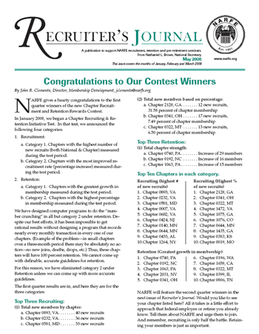



Resource Materials
NARFE publications
  Quarterly News,
  Recruiter’s Journal & Quarterly
NARFE Magazine
NARFE Question and Answer Booklet
Federation Quarterly Newsletter
Notes:
These are some of the excellent resources available for all positions in NARFE and should be referred to frequently.

Slide 9
How do you reach your audience?
Newspapers, radio and television news departments appreciate press releases
Weekly and small daily newspapers focus more on community events and organizations
Use the editorial pages of newspapers
Radio and television talk shows
Public access television, if available
in your community
Notes:
This list is only a start on where to begin to tell the NARFE story and message.
While these are the obvious ways to reach your audience, there are many more ways to explore that give the widest and most visible dissemination of NARFE’s benefits and value.

Slide 10
Creating a PR campaign
Get to know news people in community
Establish good contact info
Limit releases and press conferences to topics that are newsworthy and timely
Know your subject before contacting media
Alert press to events and photo opportunities
Notes:
It is very important that you have a PR plan and campaign. There are plenty of resources available in the handbook and on the web site to help you develop a plan.
This is only a generalized list of what should be considered.
Continue to next slide for rest of list

Slide 11
Creating a PR campaign
Don’t play favorites with contacts
Deal honestly with press
Make sure information is factual
Keep National informed of PR initiatives
Refer to www.narfewa.net for PR planning

Slide 12
Community Relations
Get to know the opinion of leaders in community
Create speakers bureau of qualified NARFE members for community presentations
Encourage NARFE members to serve on citizens advisory committees
Take part in public service programs
Attend local government meetings and hearings
Notes:
Remember that Public Relations is really Community relations because you are working within a community whether it is federal government or the local community.
Again, this is just a sampling of what you will find in the resources that are available to each officer or committee.
Let’s now take a look at the Membership Chair position.

Slide 13
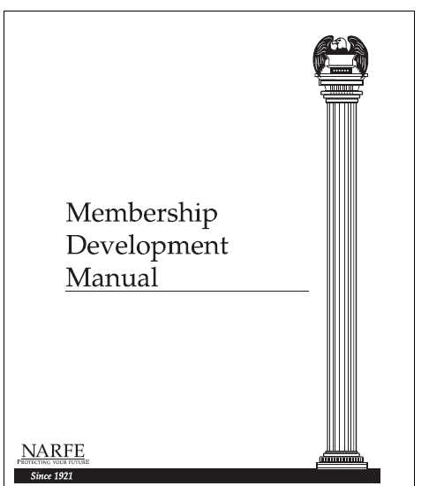
THE MEMBERSHIP CHAIR

Slide 14

Membership Chair
Basic Responsibilities
  Create, implement, monitor &
  manage membership plans and materials
  Publicize NARFE’s presence and services to federal employees, retirees and survivors
  Work with other officers to ensure activities and programs are in the interest of all members
Notes:
One of the crucial areas of chapter leadership is the Membership Chair and committee.
NARFE’s membership must continue to grow. The number of members translates into what makes a difference when presenting our concerns to Congress.
While this is not a comprehensive list of responsibilities, this will give you an idea of what this position should accomplish.

Slide 15
Membership Chair
Basic Responsibilities
  Engage chapter members in the recruiting efforts
  Communicate between chapter and federation chair and NARFE HQ staff
  Forward names and addresses of prospective members to HQ Recruitment & Retention Section
Notes:
One of the crucial areas of chapter leadership is the Membership Chair and committee.
NARFE’s membership must continue to grow. The number of members translates into what makes a difference when presenting our concerns to Congress.
While this is not a comprehensive list of responsibilities, this will give you an idea of what this position should accomplish.

Slide 16
What should a Membership Chair know?
Who can join?
NARFE membership benefits
Membership application process and incentives
Various membership options:
  Dues Withholding
  National Life Membership
  Annual Annuitant/Survivor
  Active Federal Employee Membership
  Distinguished member
Understand NARFE Membership Reports
The NARFE and Federation web sites at www.narfe.org and www.narfewa.net
Notes:
As membership chair, you and the committee must know that membership is open to retirees, active employees, spouses and surviving spouses, former employees, and former spouses eligible for survivor annuity and that the joining costs vary depending on type of membership.
Be very familiar with all of the benefits and there are many.
Keep informed on the most current incentive programs and make chapter members and prospects aware of them when recruiting.
Get to know all of the membership forms and how they apply. Make sure you always have copies available to give to prospective members or current members who are interested in changing their membership payment or status
Learn to use the membership reports to retain members, identify potential members and provide services to existing members.
The NARFE web site can provide almost everything you need to be an effective membership chair.
If you don’t have access to the web site, have someone download them for you or order them through the NARFE Publications department using the F-18 form. Remember they are at no cost you or the chapter.

Slide 17



Tools of the Job
Membership Development Manual (F-19)
NARFE LetterBook
Requisition Form F-18 for all forms
NARFE Publications & web sites
Recruiting Posters
Notes:
Additional important tools that you will want to review and have available.
Membership Development Manual provides guidance on all areas including planning, recruiting, retention, leadership and member services. This has excellent examples of the many forms and tools to track and update membership requirements.
The Letter book is a compilation of sample letters appropriate for all situations dealing with membership
The Recruiter’s Journal is a quarterly publication with many recruiting/retention ideas and will be the place to go for that latest incentives, programs and updates.
The two NARFE Recruiting Posters can be downloaded from the web site or ordered and can be copied to use throughout your recruiting area. Always have a few of them on hand.

Slide 18




Membership Forms
Annual Annuitant/Survivor &
Active Employee Membership
Dues Withholding Program(F-86)
  Contains DW-2 (existing Members)
  Form DW-3 for new members
National Life Members (F-53)
Distinguished Member
F-140A
Notes:
Maintain a stock of membership forms and make sure that members in your chapter also have a few to carry with them. You never know when a conversation will end up with a new member.
Also having Dues Withholding information available is a good way to ensure we don’t loose those new members.
National life members again is an excellent retention tool so be prepared to make it available to members and prospects.
Become familiar with the requirements for Distinguished member.

Slide 19
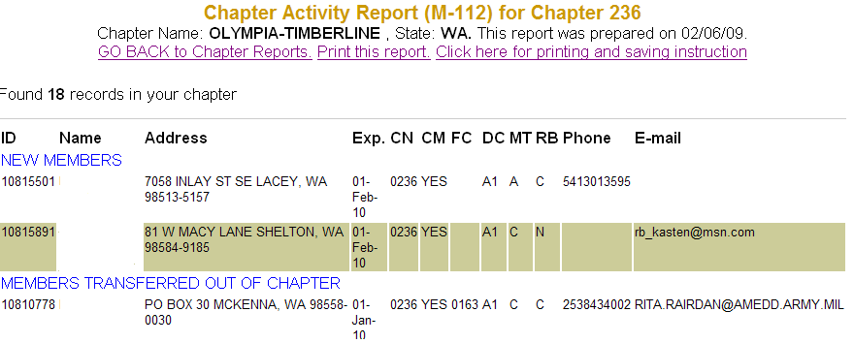
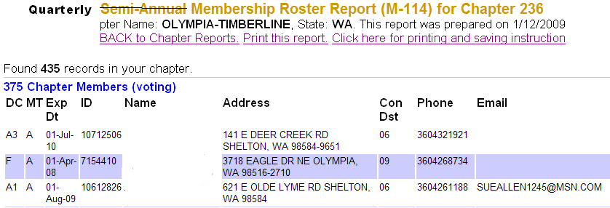
Chapter Reports
Monthly Activity Report (M-112)
Semi-Annual Chapter Roster (M-114)
Notes:
Be sure to use the different Chapter member reports as part of your overall membership plan. It is very important that you fully understand how to read these forms and the information they provide when setting and achieving your membership goals.
IMPORTANT POINT: All of the reports are on the NARFE web site where you can download them in one of three formats. You will need to know the Chapter ID and Password in order to access them. You should ask your chapter president for that ID and Password.
M-112 – Monthly Chapter activity report - National sends one copy to membership chairs and chapter presidents each month. By getting them on-line you will always be current and have valuable information available to implement your membership plans.
The M-114 is now available quarterly and will be the tool you use to keep your membership up to date. Any corrections or additions should be noted and a copy returned to National.

Slide 20
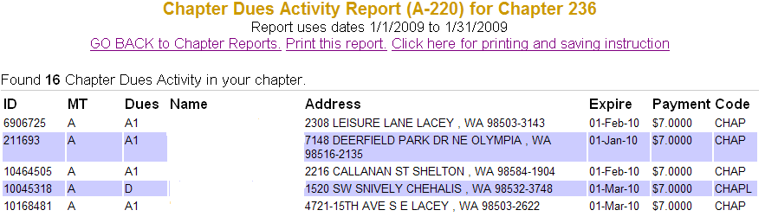
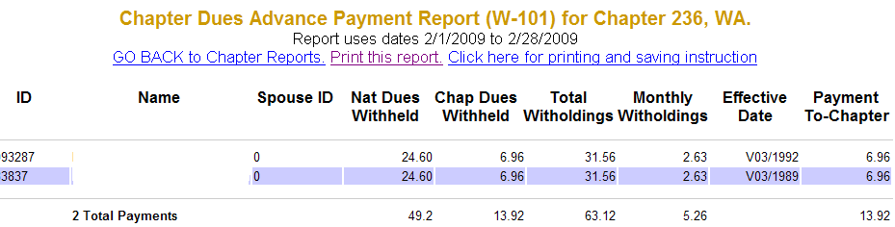
More Important Forms
Chapter Dues Report (A-220)
Monthly Dues Withholding Report (W-101)
Notes:
A-220 - Working with the Treasurer, the A-220 report will keep you current on who has paid dues which may not be reflected on the monthly M-112.
W-101 – This reports tells who have signed up for dues withholding and may be very important when making membership retention plans such as the Retention/Attention program.
NEXT SLIDE

Slide 21
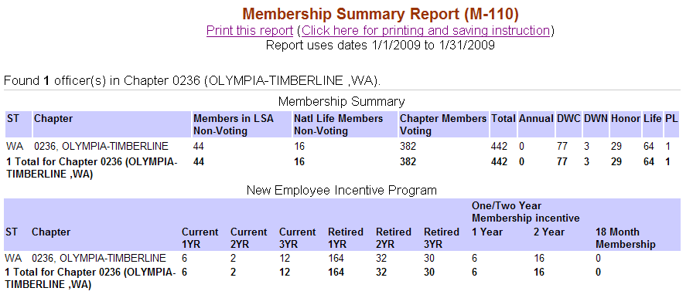
MORE REPORTS
Monthly Federation Membership Summary (M-110)
Notes:
M-110 - Monthly each chapter is recorded on the federation report M-110. Your chapter president or the Federation Membership chair will provide you with this report. It is a good way to check to make sure your reports are accurate.

Slide 22
Membership Program
Form a membership committee
Establish attainable recruiting and retention goals and objectives
Develop a yearly plan and submit to the Federation membership chair
Take every opportunity to recruit, i.e. Health Fairs, pre-retirement seminars, community events and activities
Be informed and vocal representative of NARFE benefits and services
Provide monthly membership activities report to chapter
Notes:
Here are some things you will want to do early on as membership chair.
Bullet 1 and 2:
Form a membership committee - Keep in mind that it is always easier and more effective to have a group of people to share the workload and job.
Bullet 3: The Federation Membership Chair will inform you when to submit your yearly plan. By having an approved plan, there may be matching funds to support your chapter’s effort. Check the Federation web site for details at www.narfewa.net.
Recruit where ever you can. Health Fairs, pre-retirement seminars, community event and activities such as local fairs, farmers markets, etc.
Be the VOICE for NARFE
Make sure you report your activities to members of the chapter and ask for this help frequently

Slide 23
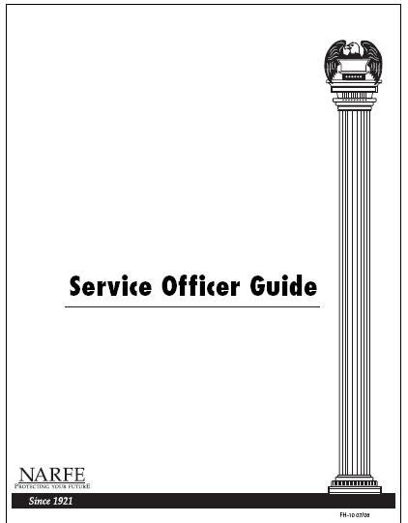
THE SERVICE OFFICER
Notes:
Another very important officer in your chapter is the Service Officer so what are their duties

Slide 24
Service Officer
Roles & Responsibilities
Meet the practical needs of members involving benefit programs
Facilitate between members and OPM
Help with correct preparation and expedite applications for benefit claims
Help obtain information about FEHBP, Medicare and programs of other agencies
Review useful information at chapter meetings and in the chapter newsletter
Notes:
The Chapter Services officer is a key figure in the operation of an effective and efficient service program.
The roles and responsibilities are extensive but very rewarding.
REVIEW LIST

Slide 25
Service Officer Needs to Know
Annuity payments (amount, direct deposit, COLAs)
FEGLI Insurance and FEHB procedures
Entitlement to survivor benefits under current OPM laws
Designation of beneficiaries
Notes:
These are the primary areas that a Service Officer may be called upon to provide assistance.

Slide 26
Service Officer Needs to Know
Separation, divorce and remarriage effects on benefits
Death benefits
State and federal income taxes
Disability benefits
Social Security referral information

Slide 27

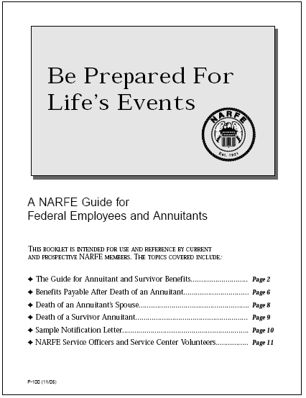
Tools of the Job
Service Officers Guide (FH-10)
Chapter Service Officer (F-58)
Service Officers & Centers (F-107)
NARFE publications & web sites at
www.narfe.org & www.narfewa.net
OPM web site at www.opm.gov/asd
Federation Service Officer newsletter
Notes:
The NARFE web site can provide almost everything you need to be an effective Service Officer or you can order materials with F-18.
The Service Officers Guide is a comprehensive publication guiding you through the many aspects of servicing members and gives examples of the forms
The Chapter Services Officer pamphlet (F-58) is a brief outline of duties and a good guide to start you off on the right foot.
Each member should be familiar with the F-107 Service Officers and Centers pamphlet
The Quarterly News has latest topics that will benefit you. The new Q&A book now has those frequently asked question with answers that will help you provide information requested.
The Federation Service Officer also sends a quarterly newsletter that will keep you current with information.
OPM produced two pamphlets RI-20-59 “Information for Annuitants” and RI-25-26 “Information for Survivor Annuitants as well.

Slide 28
Areas of Service Assistance
Death Benefits
Change in Marital Status
Federal and State Income Tax
Federal Employee Health Benefit Plan
Long-term Care
Medicare
TRICARE for Life
Veterans Benefits
Unemployment Compensation
Notes:
These are just a few of the areas that you may encounter so you should be familiar with them generally and knowledgeable about where to find additional information or contact information

Slide 29

THE LEGISLATIVE CHAIR
Notes:
The primary function of NARFE is legislative as shown here.
NARFE’s clout for political power and influence is at the grassroots level which relies upon its members to make our voices heard.
The Legislative chair and committee provides the expertise and direction to enable members to present our position and voice.

Slide 30
Legislative Chair
Roles and Responsibilities
Committed individual who effectively harnesses the full legislative potential of NARFE members
Contact person who relates to and deals with diverse groups of people
Motivates and moves membership to take active role in the legislative process
Notes:
There are three primary duties and responsibilities of this position.

Slide 31
Legislation is Not a Spectator Sport
Knowledge is power so take the time to learn the Congressional process
First Rule: Always keep up-to-date on possible legislative and political action
Few, if any, issues remain fixed
Changes can occur rapidly in support of
or opposition to legislation
Use the most relevant information possible
Notes:
It is very important that you do your homework and follow these simply but important guidelines to being an effective legislative chair.

Slide 32
Tools of the Job
NARFE publications & web sites at
www.narfe.org & www.narfewa.net
NARFE Legislative Hotline (GEMS)
NARFE Congressional Directory
Forms F-106, L-1 and L-2
Notes:
The NARFE web site can provide almost everything you need.
If you don’t have access to the web site, have someone download them for you or order them through the NARFE Publications department using the F-18 form. Remember they are at no cost you or the chapter.
These are just some of the pamphlets and pieces of information that will help you bring the message and strengthen your point when meeting Congressional members who could support our issues and points.

Slide 33
Good Resources
Daily newspapers and national news magazines (Time, Newsweek, etc.)
Federal Times
Federal Employee News Digest
Congressional Records
Congressional Quarterly
National Journal
C-SPAN or Network news programs
Notes:
Know the subject matter better than your Member of Congress.
If you are aware of general political philosophy of the current administration, Congressional party in control and sentiments and calls for change being expressed by national leaders, you can often anticipate and prepare to deal with legislative proposals and actions affecting us.
This is a good list of resources to assist you in keeping in tune with what is happening.
Obviously there are many more sources.

Slide 34

NARFE-PAC Chair
Works with and reports to State
  NARFE-PAC Coordinator
Educates chapter leaders and members on NARFE-PAC’s importance
Motivates members to contribute to NARFE-PAC and become involved in the political process
Legislative chair often serves as chapter level NARFE-PAC chair
Notes:
Utilize the Federation NARFE-PAC Coordinator to assist with information and additional tools to make members aware of the importance of NARFE-PAC support to candidates.
Communication is the key to the success of any organization so your newsletter and the editor are key members of your chapter when trying to get your message out.

Slide 35
THE NEWSLETTER EDITOR

Slide 36
Newsletter Editor
What is their job?
Prepares newsletter to communicate
  important information
  news about chapter activities
  promote membership improvement and retention
Designs newsletter for a specific audience - NARFE members and potential members
Recruits a committee to gather information, prepare for mailing and distribution
Newsletter templates available on the NARFE web site.
Notes:
Remember that conveying information is the most important part of being the newsletter editor
Providing that information doesn’t have to be expensive or elaborate. Some of the best newsletters consist of just one sheet on both sides.
What is important is that you communicate and provide the essential information to members.

Slide 37
News Sources
NARFE and Federation Web sites and updates
at www.narfe.org and www.narfewa.net
NARFE Legislative Hotline (GEMS)
NARFE and Federation Publications
Daily newspapers and national news magazines (Time, Newsweek, etc.)
Federal Times and Federal Employee News Digest
Chapter officers, committees and members
Notes:
News can come from many sources so don’t forget to use them all.
This is just a few that you might find beneficial in filling those blank pages of the newsletter.
NOTE: Remember, however, that you don’t want to reprint information that is already available in existing publications such as NARFE magazine. Your readers have already received that information. They want what is new.
There are many publications that annuitants may not be aware of or have access to such as Federal Times and Digest and those have excellent information.
And don’t forget your own members, officers and committees for articles, poems, information from similar organizations, i.e. AARP or Senior Citizen organization with similar issues.

Slide 38
Standard Newsletter Guidelines
Uses brief, declarative sentences, and descriptive headlines to enhance understanding, interest, and readability
Each issue should contain;
  Name and contact information of chapter officers including email addresses
  Editor contact info
  Calendar of upcoming events
  Names of senators/representative with local and DC contact information.
Use headlines (headings)
Notes:
Regardless of size of newsletter, each issue should contain the following:
Read First bulleted items:
Headlines – Use them liberally as it enables the reader to read quickly and easily absorb the message.

Slide 39
More Newsletter Guidelines
Have a President’s column
Identify writers
Cover pertinent NARFE issues
Have a consistent design
Have good layout
Be aware of copyright issues
Check facts and accuracy, i.e. spelling
Regularly check mailing addresses for deceased, moved or others
Notes:
President’s column should be clear, concise and oriented to most important chapter business such as recent events, policy meetings, upcoming events and issues of broad interest to members.
Be sure to identify the writer first if “I” or “We” is used in article
While variety is nice and can relieve a dull newsletter, what members want and read are those item pertinent to them and NARFE.
By having a consistent design, reader can readily refer to sections of interest to them.
Good layout is generally:
Double-column (easier to read)
If more material than will fit on standard sheet of paper, try a larger 11 x 17
Underline important dates and times or type them in caps for easy reference and emphasis
Some chapters may sell small ads but check with postmaster where you mail to make sure you are within Postal Service guidelines
Any article or story disseminated by NARFE HQ may be reproduced. If from another source, make sure it is not in violation on copyright regulations

Slide 40
Help is only a phone call or email away!
Contact:
Your chapter president and officers
Your District Vice-President
Washington State Federation Officers and web site (www.narfewa.net)
Regional Vice-President
National NARFE Headquarters and web site
Notes:
Now you have the basics. What is you have questions or need help?
Help is out there and remember to call upon them.
Good Luck and enjoy!!!

