Slide 1

THE NARFE CHAPTER
Chapter Leadership – 101
Orientation and Training
Notes:
How many of you were elected or appointed to leadership of your chapters without really knowing or understanding what the job involved?
How many of you had any formal orientation or training for your position? You may have attended a District workshop after you had been in office for almost a year.
The purpose of this presentation is to provide the basic overview and resources available to an individual who becomes the leadership of a chapter.
This presentation can also be used as a recruiting tool when surfacing possible candidates and to get new (and even returning) leadership off to a good start so that we better retain leadership.
If may be used by just going to the position that you are wanting to recruit or in its entirety.

Slide 2

Resources to Help You Begin
All available on the NARFE web site in downloadable PDF files or can be ordered on F-18
F-54
F-55
F-10
F-56
Notes:
Much of the material in this presentation is based on the forms already available to NARFE leadership as shown above and can be downloaded from the NARFE web site or ordered on a F-18 form.
I would suggest that each chapter have copies of each of these when recruiting for candidates for positions within the chapter.
The F-10 is the basic manual and each chapter should have at least one copy for chapter officers and committees.
This presentation will be an over view and orientation of the positions of the elected officers of the chapter.
How many of you were aware that this material existed or that the chapter had the latest editions? I was never informed nor given anything except the brown box with a lot of old papers.

Slide 3
CHAPTER PRESIDENT
Notes:
You’ve been elected to the position of Chapter President.

Slide 4
I’m a Chapter President, now what do I do?
Establish local plans to achieve NARFE objectives and goals
Chair the executive committee and preside at chapter meetings
Liaison with federation, national office and chapter members
Encourage and support training
Appoint committees
Notes:
“Now what do I do? I am sure you have frequently heard that comment.
So let’s begin with reviewing the key roles and responsibilities of the chapter president and the other officers.
Read the bullets:

Slide 5
Chapter President
Encourage growth and retention of membership
Identify, motivate and develop replacements for committee positions
Ensure each officer and chair is familiar with duties/responsibilities
Represent chapter at official events

Slide 6
What tools do you need to do your job?
Be familiar with
  Chapter/Federation constitutions and bylaws
  National Articles of Incorporation and bylaws
  Chapter/Federation Officers Manual (F-10)
  Past chapter minutes & treasurer’s reports
  Robert’s Rules of Order
  All NARFE publications, forms and reports
Notes:
It is important that a Chapter president understand how NARFE is organized and its legal obligations.
These are the major tools needed in order to guide your first steps in your position.
Chapter/Fed Constitutions and bylaws
National Articles of Incorporation and bylaws – Each chapter should have a copy in their archives and files
Past chapter minutes & treasurer’s report – The historical record of past actions is a great way to become informed about past operations of the chapter
Robert’s Rule of Order – Every chapter should have a copy
As president, you should be completely familiar with every publication and form available. We will going over some of these shortly
In today’s world, the internet and the web sites are our greatest tools. Get to know the NARFE web site as it probably the best and most accurate tool you can have in your arsenal.

Slide 7
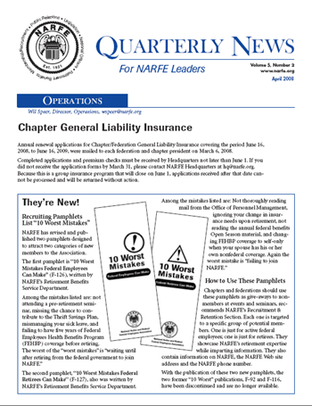
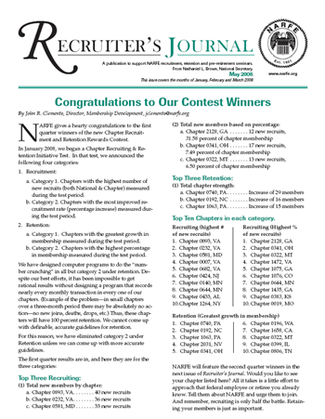
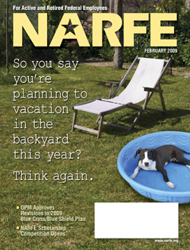


Resource Materials
NARFE publications
  Quarterly News,
  Recruiter’s Journal & Quarterly
NARFE Magazine
NARFE Question and Answer Booklet
Federation Quarterly Newsletter
Notes:
These are some of the excellent resources available for all positions in NARFE and should be referred to frequently.
The Quarterly News and Recruiter’s Journal can be downloaded from the NARFE web site and is also mailed to chapter leaders.
The newly revised Question and Answer Booklet can be ordered either on line or on a F-18 form.
Federation and chapter leaders will receive by mail “The Federal Reporter” or you can download it from the Washington Federation Web site.
The Quarterly News, Recruiters Journal and Federation Quarterly newsletter “The Federal Reporter” provide many tips, hints and past practices that can greatly enhance the chapter’s operations.
How many use these publications and information on a regular basis?

Slide 8
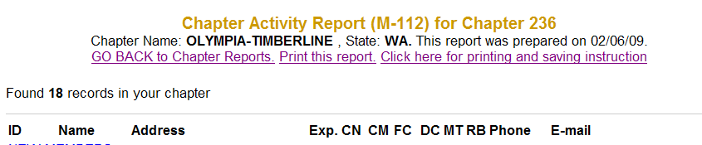
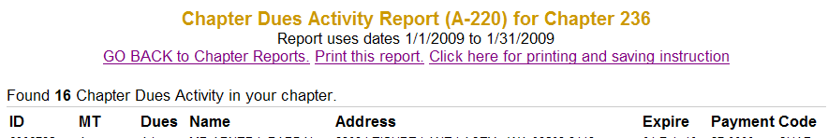
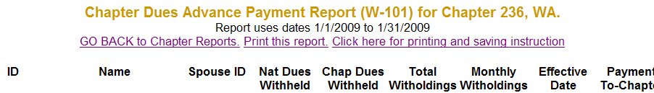
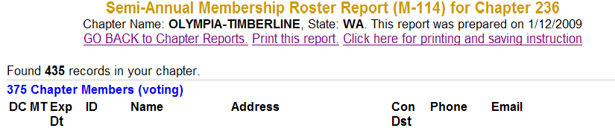
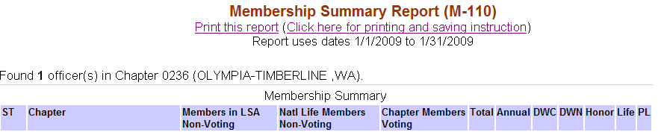
Resource Materials
NARFE and Federation Web sites and updates
at www.narfe.org & www.narfewa.net
HQ monthly and quarterly chapter activity reports, i.e. M-112, M-114, A-220, M-110, W-101
Notes:
As I said earlier, the NARFE and Federation web sites are probably the best and easiest way to keep up to date and current on what is happening in NARFE.
All of the reports can be downloaded in one of three formats. You will need to establish a Chapter ID and Password to access them on the web site. It is a good idea to inform your chairs and other officers of the ID and Password so they can access them as well.
You will have five major monthly and quarterly chapter activity reports that you will want to review and be familiar with. There are:
M-112 monthly report
M-114 (now quarterly) Semi-annual Member Roster
A-220 Due activities
W-101 Advanced Payment (Dues withholding)
M-110 Summary of members.
While the officers or chairperson in the respective committees will be working with these reports, it is important that you are familiar with them as well.

Slide 9
The Chapter Constitution & Bylaws
Each chapter should have a constitution and bylaws
Form F-21 is good template for bylaws
New bylaws and any subsequent amendments submitted to HQ for approval.
Forward any bylaws as they are amended to Federation and Chapter Services at HQ
Notes:
The chapter’s constitution and bylaws are important as the basic guides to how the chapter functions.
If your chapter doesn’t have bylaws and constitution, the F-21 is a good template for writing bylaws.
Things like terms of chapter officers , which positions are elected or appointed, conducting of elections and rules of operation are often in bylaws or constitutions.
However, try to keep your bylaws and constitutions very general and broad and put the specifics and details in standing rules or procedures guides or manuals.

Slide 10
Other duties
Establish an executive committee, as appropriate, either by election or appointment per chapter bylaws
Appoint a nominating committee (unless elected)
Appoint other officers and standing committees as required or needed
Notes:
Of course, there are always other duties not specified in the job description and here are a couple of key ones that the president will want to make sure happens.
The president should know the duties of the other officers and chairs to provide direction and support
The nominating committee should be appointed well in advance before the election. It is really a good idea that this be a standing committee that works year round to identify and recruit potential candidates of office.
And lastly, you can’t do everything yourself so you will want to appoint others to head up committees to the work for you.

Slide 11
Set meeting agendas
Preside and conduct chapter business in orderly, impartial manner
Plan programs that are pertinent, interesting to members and involve them
Follow the suggested order of business unless specified in chapter bylaws
Notes:
This is pretty self-explanatory but probably the major part of the job of president.
Some chapters have a program chair in charge of monthly programs but it is important that the president be part of that planning as it will be crucial to setting the meeting agenda.
Some chapters alternate programs and business meetings but it is ultimately the president’s job to have programs that meet the interest of members to provide useful and necessary information.
Lastly, always have an order of business.

Slide 12
Suggested Order of Business
Call to order
Invocation
Pledge of allegiance
Introduction of members and guests
Reading/approval of previous minutes
Treasurer’s report
Officer/committee reports
Unfinished business
New business
Announcements and appointments
Program, i.e. speaker, entertainment, etc.
Adjournment
Notes:
Chapters may vary from this order of business if stipulated in their bylaws. But this is the typical and traditional meeting outline

Slide 13
Controlling the Meetings
Always have a written agenda and
keep to the order of business
Allow members to share thoughts but keep to the overall purpose of meeting
Apply rules uniformly so timely decisions can be made
Give opportunity for all comments so long as they remains useful and constructive
Notes:
It is very important to control the meeting and makes sure the agenda is met and members have an opportunity to participate.
These are some of the methods to having orderly and productive meetings.
As stated before, have an agenda of the order of business and stick to it.
Allow members to share but keep their comments relevant to the purpose of the meeting
Give each participant equal time for discussion
Make sure comments are useful and constructive

Slide 14
Controlling the Meetings
Handle discussions in orderly manner:
  Each person has chance to speak
  Keep all speakers to rules of order and to the question
  Give pro and con speakers equal opportunities
  State each motion before discussion and vote
  President votes when it won’t affect outcome or when vote is by ballot
  Be familiar with parliamentary procedures
Notes:
If there is business presented to the assembled members for a vote or an issue needs to be discussed, it can sometimes become unruly and disorderly. Here are a few rules on how to handle discussion and come to consensus.

Slide 15
CHAPTER
VICE-PRESIDENT
Notes:
Now what about the Vice-President.
Are they only a name on a piece of paper in your chapter or are they utilized as a major part of your board.
The VP position should have defined roles and responsibilities

Slide 16
What does the Vice-President do?
Supports and backs up the president
Be prepared to assume responsibilities
and function of president, if needed
May be called upon to perform other duties, as assigned
May have a first and second vice, if warranted
Be familiar with chapter operations and duties and responsibilities of other officers/committees
Notes:
These are the primary duties of the position, but a Vice President may be called upon to perform a variety of duties. Often the Vice-President may be given major program responsibilities such as program or legislative chair.

Slide 17
CHAPTER
TREASURER
Notes:
This position is often considered one of the most important because there is money involved. Therefore it is important that we fully understand their roles and responsibilities.

Slide 18
The Treasurer’s Roles and Responsibilities
Keeps all financial records accurate and current.
  Receives chapter dues from HQ and collects chapter dues from social/associate members and other monies owed or collected by chapter
  Review direct deposits of dues from National Office and deposit any other funds received
  Disburses funds as directed by President, Exec committee or chapter’s bylaws and policies
Notes:
Most chapters have a treasurer but some may combine this with the position of secretary/treasurer or financial secretary.
Regardless of how the chapter is configured, the basic roles and responsibilities remain the same.
Let’s review these.
Go to next slide for more

Slide 19
Treasurer’s Role (Cont’d)
Makes financial reports each meeting (F-38)
Reconciles membership records and dues paid
Prepares budgets and financial reports
Forwards national/chapter dues from new members to national treasurer, if needed
  Use F-16 - Dues Transmittal Sheet
Notes:
Review the points on this slide.

Slide 20
Treasurer’s Role (Cont’d)
Disburses special/dedicated funds as soon after collection or as required
Arranges with NARFE HQ for direct deposit for chapter checks
File annually IRS Form 990-N (postcard) for the chapter
Submit quarterly Federation Per Capita Tax
Turn over all materials to successor
Notes:
Review points
Disburse dedicated funds such as multi-year membership
Set up and monitor any changes to direct deposition
Yes, you do have to file income tax forms but they are simple and on line
Each chapter is accessed a Per Capita Tax which is sent to the Federation on a quarterly basis.
Point out that the last bullet should apply to all positions and it means more than just dumping the box on the front porch and running. Go over the material and explain to the individual what is important and needs immediate attention.

Slide 21
Dues Processing
Under the NARFE dues system:
  Members pay national/chapter dues directly to National office
  National Life Members and Dues Withholding for national dues only can pay to National Office or directly to chapter
Any check received by chapter for dues should be forwarded to HQ
Social and associate member dues can be retained by chapter.
Notes:
A significant portion of the duties of treasurer deal with dues and processing them. While under unified dues, most is done directly to HQ, treasurer’s need to know how to process those instances when dues are given to the chapter.

Slide 22
What tools do you need to do your job?
F-38 – Treasurer’s Monthly Report
F-16 and F-16R – Dues Transmittal Sheet
Journal or ledger
Receipt book with carbon
M-112 and M-114 Reports
A-220 Chapter Dues Activity Report
M-130 & 131-C – Recruiting Fee Report & Active Federal Employee Bonus Recruiting Fee
W-101 – Chapter Dues Advance Payment Report
Notes:
These are the major reports and forms that you will want to use and be familiar with as treasurer.
All may be downloaded from the NARFE web site or ordered using the F-18 form.
Become very familiar with all of these reports.

Slide 23
Maintaining Records
Post books after each transaction
At minimum, use two-column journal
Retain receipts, canceled checks and letters of transmittal involving money
Reconcile chapter books and bank statement at end of month
Keep checks with bank statement for audit purposes
Use F-37 Chapter Record of Membership
Notes:
Needless to say, keeping track of the chapter’s money is important and thus requires maintaining records.
Here are some suggestions and tips to help you with the records process

Slide 24
Who else do I work with and why?
Secretary and Membership Chair to:
  Compare files so chapter roster is accurate
  Remove deceased members
  As of Dec 31 of each year, establish convention delegate numbers and membership numbers for Federation Per Capita Tax
  Review quarterly membership roster to reconcile membership roster
Federation Treasurer
Notes:
Since most of the chapter’s funding comes from membership dues, it is important that the treasurer and membership work together to reconcile all memberships.
Update and reconcile files and also remove deceased members from roster
As treasurer, you will be responsible that the Per Capita Tax membership numbers are correct.
You will receive notification from the Federation Treasurer when that is due and the proper form for sending.

Slide 25

CHAPTER
SECRETARY
Notes:
The secretary is the oracle of the chapter and good recordkeeping will go a long way to making the chapter function well.

Slide 26
The Secretary’s Roles & Responsibilities
Provides continuity to chapter activities
Basic job is to:
  Attend and record minutes of all meetings
  Notify officers/members of scheduled meetings
  Maintain roster of chapter officers & members
  Prepare all correspondence, not exclusive of another officer
Notes:
Again, the next couple of slides are the basic roles and responsibilities of the Chapter Secretary.
The Secretary should be familiar with all activities of the chapter and committees

Slide 27
The Secretary’s Roles & Responsibilities
Furnish reports and documents to federation and national offices, as required
Maintain chapter files and permanent documents
Order all supplies for operations (F-18)
Works closely with President in preparing agendas
Turn over all materials to successor

Slide 28
What tools do you need to do your job?
Be familiar with
  Chapter/Federation constitutions and bylaws
  National Articles of Incorporation and bylaws
  Chapter/Federation Officers Guide (F-10)
  Robert’s Rules of Order
  NARFE publications and website
  Monthly chapter newsletter
  Supply requisition Form (F-18)
Notes:
Like the other positions, there are certain tools that will be helpful in doing the job. You will note that these are similar to those of the president/vice president.

Slide 29

Organization - Key to Success
Be at meeting well before it begins
Determine if quorum is present
Record minutes of meeting
Maintain accurate membership roster
  Get names of new/lapsed members from treasurer and membership chair
Keep appropriate officers/committees advised of new members
Notes:
Most of the organization’s ministerial functions will fall on the secretary’s shoulder. Therefore, it is important that the secretary is well organized and timely.
The following will aid in carrying out those functions effectively.
While some chapter may have the membership chair maintain the membership roster, it works best if they work together to maintain accuracy.
When there no membership chair, then the secretary assumes the role.

Slide 30
More Keys to Success
Maintain copies of constitutions, bylaws, etc and all correspondence, minutes, reports and historical papers.
Maintain lists of committee appointment and description of functions
Work closely with treasurer for accurate records and reports
Notes:
The secretary is probably going to be the repository of all papers.
In addition to working with membership, the secretary will also need to work with the treasurer to ensure accurate records and reports.

Slide 31
Reporting Requirements
Submit F-7, Chapter Officer Roster, immediately after elections with names, memberships #, addresses and contact information
  Submit to National Office, Federation President and Secretary either on-line, by fax or mail
  Provide same contact information on all other committee positions, as soon as known
  Any additions, deletions and changes in information, report as soon as possible on a separate F-7
  Any chapter dues changes are reported to NARFE Federation and Chapter Services Department
Notes:
Like all good organizations, there will always be reports to take care of.
The maintaining of the F-7, chapter officer roster may be one of the most important as it enables Headquarters and others to know who to contact to disseminate information.

Slide 32
More Reports
In January, send list of all deaths of members during previous year to Federation secretary or membership chair
Coordinate submission of materials required from chapters for federation conventions i.e. resolutions/bylaws, list of delegates, delegate credentials
Keep abreast of record-retention materials
Notes:
It is extremely important to keep current on deceased members. You may also include social members in the list of deaths as this list will be needed for the Federation memorial service at convention.
Timely submission of convention documents is important and should be carefully monitored.

Slide 33
Minutes in Brief
Record what is done, not what is said
  No opinions or editorial remarks
Summarize speeches given at meetings
Sign and date minutes after “respectfully submitted”
Type or write legibly in ink
Have minutes of previous meeting available for vote
Note date read, approved and/or corrected
Notes:
Keeping a record of an organization is usually in the form of minutes. Remember, history can only be recalled accurately it is written down.
So, let’s look at some guidelines that should be considered when preparing minutes.
One of the biggest mistakes made by secretaries is to record everything that is said. Because Minutes are the official record of the chapter, they should reflect only what was done, not everything that was said.
It is not necessary to include a speakers entire speech.
It is preferable to have typed minutes but if there is no other option then legible in INK.
Always have previous minutes so when a vote is taken on previously presented business, you have the record of the action taken.

Slide 34
Minutes in a Brief
Record name of who made motions, seconds not necessary
Prepare original and one copy for secretary file and permanent file…President may want copy
Secure chapter minutes as they are official records
Record votes by ballot or show of hand by results only
Record number of votes only on “sticky” or controversial issues.
Notes:
There is always a questions and discussion about how to record motions and if names should or shouldn’t be in the minutes. Robert’s Rules says name of person who made the motion but no name of the person who seconds.
The recommended copies are original and one copy and usually the president will want a copy although it is not a requirement.
You only need to record the number of votes if taken by ballot or by show of hands. Voice yeas and nays are not recorded, only that they passed or failed.

Slide 35
Maintaining Chapter Records
Records are property of the chapter
Retained records include:
  Chapter charter, constitution, bylaws, all application for chapter charter (F-19)
  Federation Convention Resolution Forms (WSFC-4)
  Annual Audit or financial review report
  Chapter ZIP code assignments and changes
  Record of deceased members (only if not kept by Treasurer or Membership)
  Record of chapter property, i.e. flag, banner, etc.
Notes:
This is a good guide for maintaining of chapter records.

Slide 36
FOR ALL OFFICERS - Help is only a phone call or email away!
Contact:
Your District Vice-President
Washington State Federation Officers and web site (www.narfewa.net)
Regional Vice-President
National NARFE Headquarters and web site (www.narfe.org)
Notes:
Now you have the basics. What if you have questions or need help?
Help is out there and remember to call upon them.
Good Luck and enjoy!!!

