Slide 1




REGION X CONFERENCE
VANARFE SERVICE OFFICER PRESENTATION
SEPTEMBER 10 – 13, 2013
PIGEON FORGE, TN
JOHN & DR. CONSTANCE BAILS, Ph.D.
VFC CO-SERVICE OFFICERS

Slide 2
AGENDA
NARFE Organization, Mission & Vision
What is a Service Officer
Duties of a Service Officer
Be Prepared for Life's events F-100

Slide 3
NARFE Organization
HEADQUARTERS
REGION
1
VP
REGION
11
VP
REGION 111
VP
REGION
IV
VP
REGION
V
VP
REGION
VI
VP
REGION
VII
VP
REGION
VIII
VP
REGION
IX
VP
REGION
X
VP
FEDERATIONS
7 STATES
FEDERATIONS
4 STATES & DC
FEDERATIONS
6 STATES & VI
FEDERATIONS
5 STATES
FEDERATIONS
7 STATES
FEDERATIONS
4 STATES & R PANAMA
FEDERATIONS
5 STATES
FEDERATIONS
4 STATES & R PHILIPPINES
FEDERATIONS
5 STATES
FEDERATIONS
5 STATES
AREA VICE
PRESIDENTS
AREA VICE
PRESIDENTS
AREA VICE
PRESIDENTS
AREA VICE
PRESIDENTS
AREA VICE
PRESIDENTS
AREA VICE
PRESIDENTS
AREA VICE
PRESIDENTS
AREA VICE
PRESIDENTS
AREA VICE
PRESIDENTS
AREA VICE
PRESIDENTS
AREA VICE
PRESIDENTS
CHAPTER PRESIDENTS
CHAPTER PRESIDENTS
CHAPTER PRESIDENTS
CHAPTER PRESIDENTS
CHAPTER PRESIDENTS
CHAPTER PRESIDENTS
CHAPTER PRESIDENTS
CHAPTER PRESIDENTS
CHAPTER PRESIDENTS
CHAPTER PRESIDENTS

Slide 4
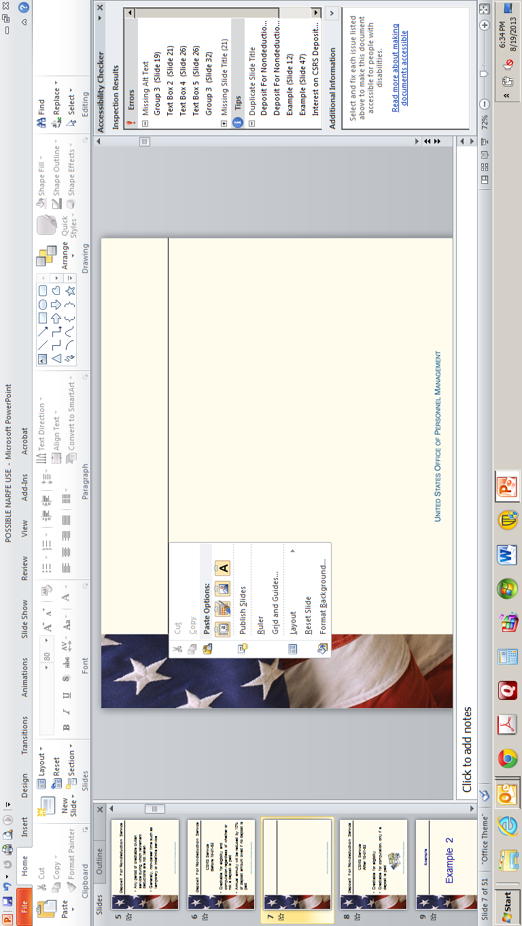
NARFE MISSION STATEMENT
To support legislation beneficial to current
and potential federal annuitants and to
oppose legislation contrary to their interests.
To cooperate with other organizations and
associations in furtherance of these general
objectives.

Slide 5

NARFE VISION STATEMENT
To ensure that:
• NARFE is recognized as the association
devoted exclusively to serving and protecting
the earned entitlements, rights and benefits of
all federal retirees, employees and survivors.
• All members have representation with the highest levels of government for resolution.

Slide 6


DUTIES OF A CHAPTER SERVICE OFFICER
When You need a helping hand I can help
Where do I go from here?

Slide 7
Chapter Service Officer
The Chapter Service Officer reports to the Chapter President.
Each VFC Service Officer should strongly encourage all Area VP’s via chapter Presidents to appoint a Chapter Service Officer and, in medium size and large chapters, a service committee to develop effective, responsive service programs.

Slide 8

CHAPTER SERVICE OFFICER APPOINTMENT
The president recruits and appoints the chapter service officer.
He or she serves on the executive committee of the chapter.
The appointment is for a one- or two-year term of office.

Slide 9
The service officer keeps informed by reading VA-NARFE monthly newsletters and the NARFE magazine for latest FERS and CSRS information. They receive mailings from the VFC service officer. All Service Officers should sign up to receive OPM Benefits Administration Information https://registration.golearnportal.org OPM frequently send out electronic updates on important changes. Follow OPM on Twitter http://twitter.com/FedEmployeeBen
To view OPM Open Season Face book page and become a fan at www.facebook.com/fedbenefits

Slide 10
They keep the chapter supplied with “Essential Information” F-100 Be Prepared for Life’s Events; used later by beneficiaries to make pension, benefit and insurance claims.
F-100’s should be handed out at monthly chapter meetings and mailed to chapter members when requested; by Chapter Service Officers.

Slide 11

They are on the agenda of the monthly chapter meeting, to report briefly on current pension and benefit concerns.
Members need to be abreast of the latest available information.
They need to be known personally as the service officer.
Members should feel free to ask them for help with problems.

Slide 12
They make phone calls, send cards, or express condolences in person, when a local chapter member dies.
The condolence is on behalf of all the local chapter members.
It’s also a way of offering to help or to answer questions.
They raise the survivor’s awareness of NARFE resources.

Slide 13

Sometimes the survivor's may ask for assistance to complete forms and write letters to assure that survivor benefits continue.
They may need contact information to notify OPM or VA or other government agencies of the death.
In their grief, they may ask for other information or guidance.
The service officer may suggest “Next Steps” they may take, drawn from the F-100 Be Prepared for Life’s Events

Slide 14
Each “open season” the service officer should remind their chapter to schedule a qualified speaker or to publicize workshops on features of OPM health benefit plans.
Speakers should present balanced information on options.
They should emphasize that needs changes as lives change.
Peace of mind requires balancing annual cost/benefits.
Workshops should help members make good decisions.

Slide 15
Your service officer should attend the state convention each year to receive the latest service training.
They enroll by marking “Service” on the registration form.
It is our goal as Service Officers to provide relevant, reliable and Verifiable service to NARFE Members!
The local chapter should appoint, train and encourage their service officers to be a resource to people facing issues regarding pension, health insurance and other issues facing active or retired federal government workers.

Slide 16
SPECIFICALLY CHAPTER SERVICE OFFICERS accomplish the following;
Duty 1. Meet the practical needs of chapter members
Duty 2. Facilitate liaisons between members and OPM
Duty 3. Help expedite applications for benefits
Duty 4. Help members obtain info about FEHBP and Medicare
Duty 5. Help members obtain info about Social Security/ Tricare for Life

Slide 17
AND NOW
Be Prepared For Life’s Events NEW F-100
A NARFE Guide for Federal Employees and Annuitants
What Your Survivors Should Know

Slide 18



BE PREPARED FOR
LIFE’S EVENTS
What Your Survivors Should Know
The purpose of this guide is to help you organize
your personal and financial information in one
location so your survivors will have the information
they will need to handle your affairs upon your death.

Slide 19
What Your Survivors Should Know! NARFE F-100
PERSONAL INFORMATION P-1
FAMILY INFORMATION P-2
RETIREMENT ASSETS P-3
MILITARY SERVICE, RETIREMENT, VETERANS BENEFITS P-4
SOCIAL SECURITY BENEFITS P-5
OTHER RETIREMENT INCOME SOURCES P-5
FINANCIAL INFORMATION P-7
LIABILITIES P-11
INSURANCE P-12

Slide 20
THREE VERY IMPORTANT STEPS!
Notify OPM, VA, DOD or Social Security when an Annuitant has deceased
Return un-cashed Treasury checks to the appropriate financial institution
Obtain several copies of the death certificates (Cost is low)

Slide 21


F
1
2
SERVICE OFFICERS
3
MEMBERSHIP
PUBLIC RELATIONS
WORKING
TOGETHER
IS A
A WINNER!

Slide 22


USEFUL TELEPHONE NUMBERS AND WEBSITE URL / ADDRESSES
Protecting The Future for
Active and Retired Federal Employees
USEFUL TELEPHONE NUMBERS & WEBSITE ADDRESSES
OFFICE of PERSONNEL MANAGEMENT (OPM) RETIREMENT INFORMATION
1 888 767 6738 – retire@opm.gov
NARFE HEADQUARTERS 1 800 456 8410 NARFE.ORG
DEPARTMENT OF VETERAN AFFAIRS 1 800 827 1000 VA.GOV
DEPARTMENT OF DEFENSE 1 800 321 1080 DFAS.MIL
SOCIAL SECURITY 1 800 772 1213 SSA.GOV
INTERNAL REVENUE SERIVICE 1 800 829 3676 IRS.GOV

Slide 23
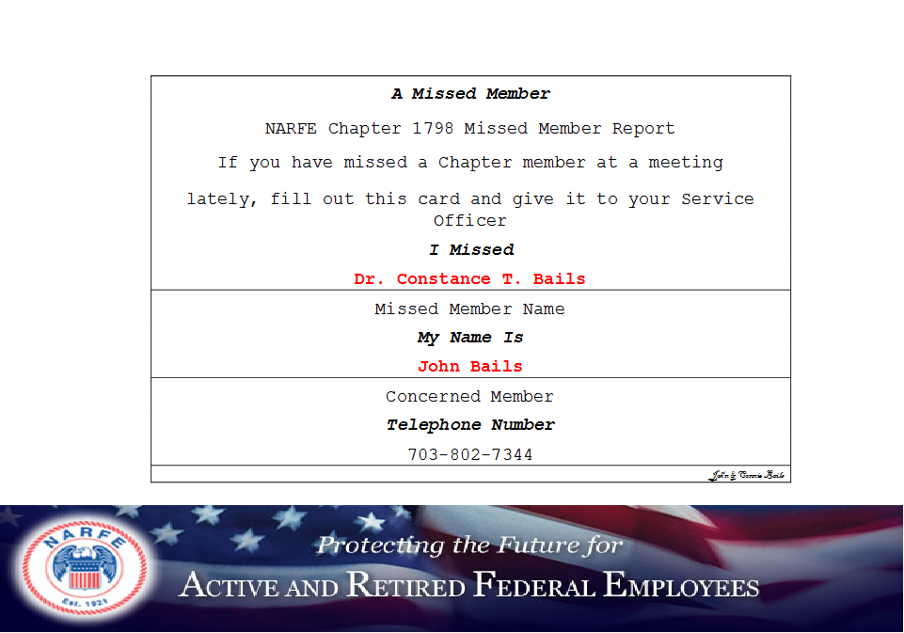
Missed Member
737 MISSED MEMBER CARD

Slide 24
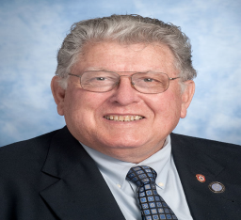
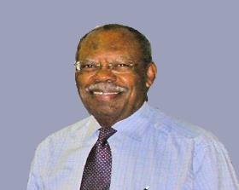


VFC PRESIDENT
LUTHER SANTIFUL
REGION X VICE PRESIDENT
WILLIAM “BILL “ MARTIN
NARFE-CHALLENGED AS NEVER BEFORE!

Slide 25


2013 REGION X PRESENTATION
THANK YOU!
NARFE-CHALLENGED AS NEVER BEFORE

