Slide 1
Social Security: With You Through Life’s Journey…
Produced at U.S. taxpayer expense
Notes:
Notes to speaker:
Please remember to test the video on Slide 2 and adjust the computer’s volume in the room where you will be speaking BEFORE you are introduced and begin your presentation. If you are using a CD-R or thumb-drive with a non-SSA computer provided by the organization that requested the speech, the captions may not work if the STAMP add-in is not already installed on their computer. If audio will not be available, you can hide the next slide – in PowerPoint, so that they will be skipped as you click through the presentation.
You will need to install STAMP to every SSA presentation laptop on which you want to display captioned videos. Here are your installation instructions:
Download STAMP: https://sourceforge.net/projects/stamp-addin/
Install STAMP Setup to the presentation laptop PowerPoint. (STAMP is a PowerPoint Add-in that allows for the addition and manipulation of captions, and caption files to videos)
Click Run
Click Next
Accept the terms of the License Agreement and click Next
Click Next
Click Install, then click Finish and restart the PowerPoint program on your laptop.
You may want to add the name of the organization or event (seminar, conference, workshop, etc.) and the date of the event to this slide by clicking Insert, then clicking Text Box, and typing in the details.
DO NOT remove the taxpayer expense disclaimer from this slide, as it is now required by law.
Be sure to thank the person who invited you to speak, thank the organization for making SSA a part of today’s event, and make a few introductory comments (such as how long you have worked at SSA, your job title, and why you feel Social Security is relevant to this event/organization).
BEGINNING OF SPEAKER’S FORMAL SCRIPT:
For more than 80 years, Social Security has helped secure today and tomorrow by providing benefits and financial protection for millions of people throughout their life’s journey.
Social Security touches the lives of every American, both directly and indirectly. As you consider the information that you are about to receive , I encourage you to think about all the ways Social Security has been linked to your life – and the lives of your loved ones.

Slide 2
About 173 million workers will pay Social Security taxes in 2017.
About 94 percent of all workers are covered or eligible under Social Security.
Notes:
About 173 million workers will pay Social Security taxes in 2017. About 94 percent of all workers are covered under Social Security.
Source for the first sentence is the 2016 Trustees Report intermediate assumptions, single year table IV.B3 (https://www.ssa.gov/OACT/TR/2016/lr4b3.html).
Source for the second sentence is OCACT estimates (unpublished)

Slide 3
Social Security Beneficiaries
November 2016
Notes:
This image illustrates the number of beneficiaries we pay. Currently, more than one in every six people in America is receiving a Social Security benefit. The majority of our beneficiaries are retired.
But Social Security is more than retirement...it is a family protection plan (almost 1/3 of the beneficiaries are disabled, dependents of disabled, or survivors).
Source: https://www.ssa.gov/policy/docs/quickfacts/stat_snapshot/

Slide 4
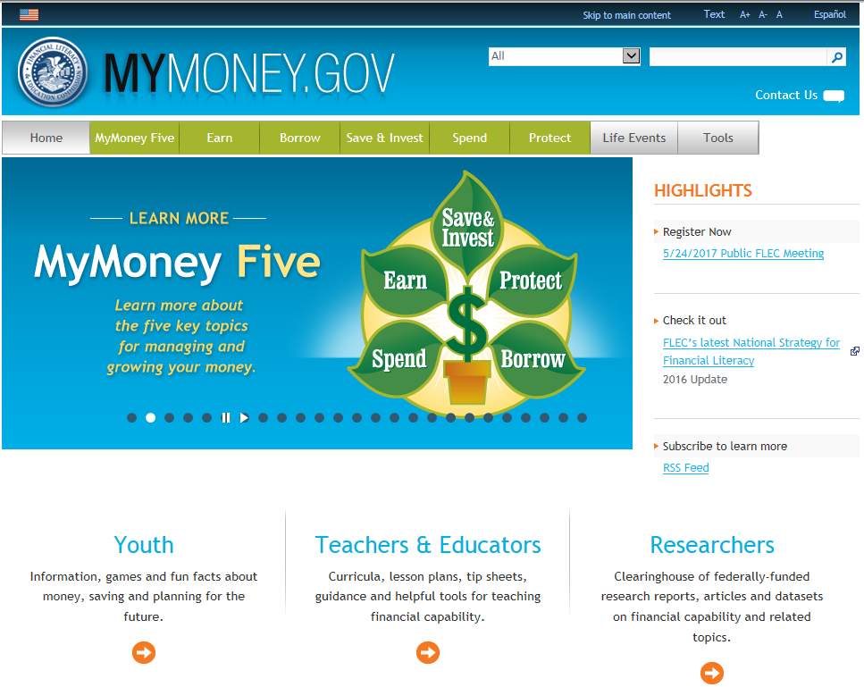
mymoney.gov or 1-800-FED-INFO
Notes:
Social Security provides a foundation on which to build retirement security. While planning for retirement, it is important that you know how much your Social Security benefit is likely to be. Also consider how much monthly income you will receive from your pension and investments. The rest of your pre-retirement income will need to be supplemented by your savings and other income. To help with your retirement income, you may want to visit the MyMoney.gov website.
MyMoney.gov is a product of the Congressionally chartered Federal Financial Literacy and Education Commission, which is made up of more than 20 Federal entities that coordinate and collaborate to strengthen financial capability and increase access to financial services for all Americans.
The Social Security Administration is one of those 20 entities.
The Commission was established by the Financial Literacy and Education Improvement Act, Title V of the Fair and Accurate Credit Transactions Act of 2003.
This is a great website to visit, even if you already have a financial planner who helps you manage your portfolio. It will help you to be more informed about financial matters, so you can ask better questions to your trusted advisors.
And this site provides free, reliable, unbiased information on a variety of financial topics.
Unlike the investment advice offered on some private financial companies’ websites, no one is trying to sell you anything through this site, which is run by the federal government.

Slide 5
Retirement Estimator
Gives estimates based on your actual Social Security earnings record
You can use the Retirement Estimator if:
You have enough Social Security credits at this time to qualify for benefits and
You are not:
Currently receiving benefits on your own Social Security record;
Waiting for a decision about your application for benefits or Medicare;
Age 62 or older and receiving benefits on another Social Security record; or
Eligible for a Pension Based on Work Not Covered By Social Security.
socialsecurity.gov/estimator
Notes:
You can use the online Retirement Estimator at www.socialsecurity.gov/estimator to get immediate and personalized benefit estimates to help you plan for your retirement.
It’s a convenient, secure and quick financial planning tool.
The Retirement Estimator, is an interactive tool that allows you to create “what if” scenarios.
You can, for example, change your “stop work” dates or “expected future earnings” to create and compare different retirement options.

Slide 6
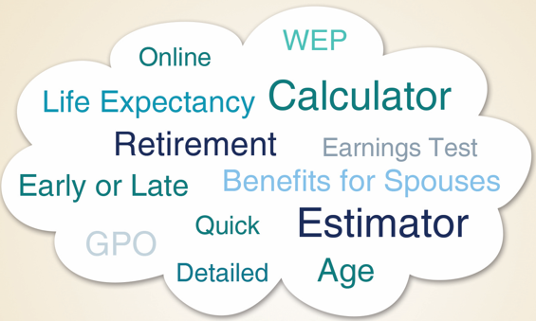
Online Calculators
Notes:
We offer 11 different calculators to help you with your retirement planning.
Just choose the one that best fits your needs!
When you visit our website, be sure to scroll down to near the bottom and click the “calculators” button.

Slide 7
Government Pension Offset
A type of benefit reduction that may affect some spouses and widows or widowers
If you receive a government pension based on work not covered by Social Security, your SS spouse’s or widow(er)’s benefits may be reduced.
socialsecurity.gov/gpo
Notes:
If you receive a pension from a federal, state, or local government based on work for which you didn’t pay Social Security taxes, we may reduce your Social Security spouses or widows or widowers benefits. We have a publication that provides answers to questions you may have about the reduction. It is available at SocialSecurity.gov/gpo.
We’ll reduce your Social Security benefits by two-thirds of your government pension. In other words, if you get a monthly civil service pension of $600, two-thirds of that, or $400, must be deducted from your Social Security benefits. For example, if you’re eligible for a $500 spouses, widows or widowers benefit from Social Security, you’ll get $100 a month from Social Security ($500 – $400 = $100).
Benefits we pay to spouses, widows, and widowers are “dependent’s” benefits. Set up in the 1930s, these benefits were to compensate spouses who stayed home to raise a family and were financially dependent on the working spouse. It’s now common for both spouses to work, each earning their own Social Security retirement benefit. The law requires a person’s spouse, widow, or widower benefit to be offset by the dollar amount of their own retirement benefit.
If you receive a pension based on work not covered by Social Security, your spouse’s, widow’s, or widower’s benefits may be reduced by the Government Pension Offset, or GPO.
To estimate your future benefits under GPO, use our Online GPO calculator at www.socialsecurity.gov/calc-gpo.

Slide 8
Government Pension Offset
2/3 of amount of non-covered pension will be used to reduce the Social Security spouse’s/widow(er)’s benefits.
Examples:
$1200 Non-covered Pension
2/3 = $800
If Social Security spouse’s or widow(er)’s benefit = $750,
no benefit payable due to offset
If Social Security spouse’s or widow(er)’s benefit =$1000,
$200 would be payable after offset
socialsecurity.gov/gpo

Slide 9
Windfall Elimination Provision (WEP)
If any part of your pension is based on work not covered by Social Security, you may be affected by the Windfall Elimination Provision.
WEP can apply if:
You reached 62 after 1985; or
You became disabled after 1985; and
You first became eligible for a monthly pension based on work where you didn’t pay Social Security taxes after 1985.
socialsecurity.gov/planners/retire/wep.html
Notes:
The Windfall Elimination Provision can affect how we calculate your retirement or disability benefit.
If you work for an employer who doesn’t withhold Social Security taxes from your salary, such as a government agency or an employer in another country, any pension you get from that work can reduce your Social Security benefits.
This provision can affect you when you earn a pension from an employer who didn’t withhold Social Security taxes and you qualify for Social Security retirement or disability benefits from work in other jobs for which you did pay taxes.
If any part of your government pension is based on wages not covered by Social Security, then WEP will apply. WEP only applies to Retirement and Disability Benefits. Survivor’s Benefits are not affected by WEP.
If you are a government employee the benefit estimate you see on your Social Security Statement might be in error because the formula used in the estimate does not take into consideration WEP.
WEP applies to the workers’ benefits. Any auxiliary benefits payable on the worker's record also would be affected.
Our Online WEP calculator allows you to estimate your Social Security benefit. Visit socialsecurity.gov/planners/retire/wep.html

Slide 10
Windfall Elimination Provision (WEP)
Normal Computation | WEP Computation
90% of the first $885 | 40% of the first $885
32% of the next $4,451 | 32% of the next $4,451
15% of the remainder | 15% of the remainder
Max WEP loss for someone who turns 62 in 2017 is $443/month
Notes:
Prior to the 1983 Amendments when workers spent most of their careers in government jobs where they did not pay Social Security taxes (non-covered employment), they received the equal benefits of the weighted benefit formula. These workers, based on their Social Security earnings record, appeared to be low wage earners; primarily because the majority of their wages were not covered for Social Security purposes. These federal, state, or local employees effectively were receiving a windfall from Social Security.
The 1983 Amendments rectified this windfall. Since they had their 40 credits, they will continue to be eligible for a Retirement benefit, but their benefit will be computed differently. The benefit formula is identical to the normal computation with the exception of the first level of the formula. Instead of receiving 90% of the first level, they will receive 40%.

Slide 11
Exception to the WEP
Years of Substantial Earnings | % of First Factor in Benefit Formula
30 or more | 90
29 | 85
28 | 80
27 | 75
26 | 70
25 | 65
24 | 60
23 | 55
22 | 50
21 | 45
20 or fewer | 40

Slide 12
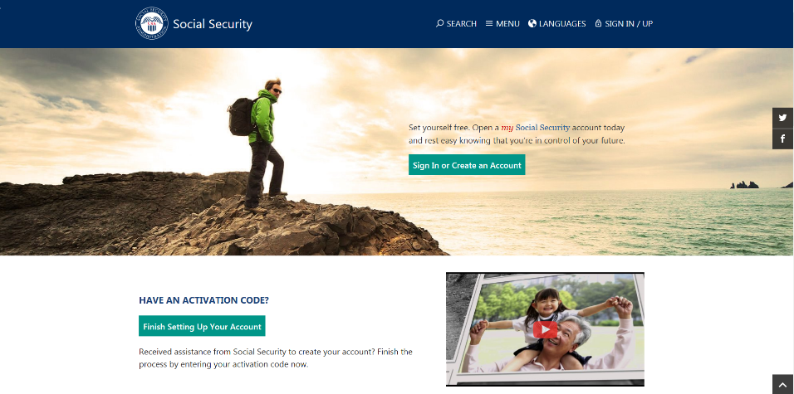
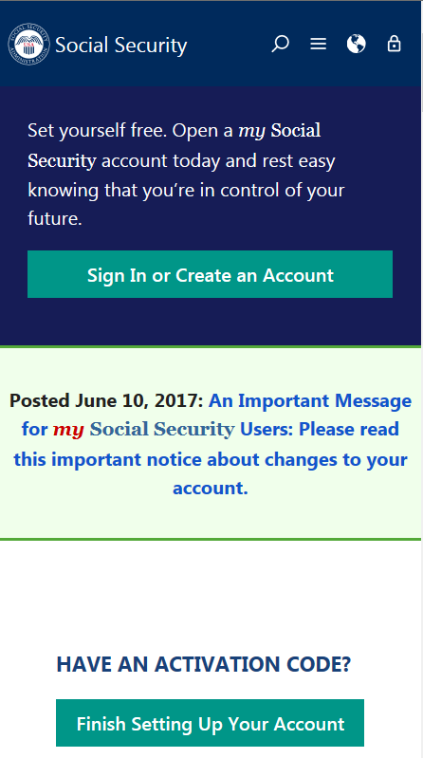
my Social Security
socialsecurity.gov/myaccount
Notes:
my Social Security is a convenient and secure suite of services designed to put you in control of your personal Social Security information, as well as help you manage your benefits when you are ready. Your account gives you the information you need whenever you want. All without calling or visiting a field office.
You can only open a my Social Security account for yourself. You cannot open an account for another person, even if you have his or her written consent. You may be unable to open a my Social Security account if you:
• Blocked electronic access to your personal Social Security information; • Recently moved or changed your name; or • Placed a freeze on your credit report.
Your online my Social Security account provides a variety of information to help you and your family. If you need help setting up your account, we have a 4-minute walkthrough video on our YouTube page.

Slide 13
my Social Security Services
If you receive benefits or have Medicare, you can:
Request a replacement Social Security card if you meet certain requirements;
Get a benefit verification letter as proof that you are getting benefits;
Check your benefit and payment information and your earnings record;
Change your address and phone number;
Start or change direct deposit of your benefit payment;
Request a replacement Medicare card; and
Get a replacement SSA-1099 or SSA-1042S for tax season.
Notes:
So what can you do with a my Social Security account?
Your online my Social Security account provides a wealth of information to help you and your family plan for your financial future.
If you receive benefits or have Medicare, you can…

Slide 14
my Social Security Services
If you do not receive benefits, you can:
Request a replacement Social Security card if you meet certain requirements;
Check the status of your application or appeal;
Get a benefit verification letter as proof that you are not getting benefits;
Get your Social Security Statement to review:
Estimates of your future retirement, disability, and survivor benefits;
Your earnings once a year to verify the amounts that we posted are correct; and
The estimated Social Security and Medicare taxes you’ve paid.
Notes:
If you do not receive benefits, you can…

Slide 15
Enhanced Security for your my Social Security Account
We recently added a second method to check the identification of account holders when you register or sign in.
This is in addition to the first layer of security, your username and password.
You will be able to choose either your cell phone or your email address as your second identification method.
Notes:
Social Security continues to evaluate and improve how we protect what’s important to you. We take this responsibility seriously, and we have a robust cybersecurity program in place to help protect the personal information you entrust to us. Adding additional security measures to safeguard your personal information — but making our services easy to use — is a vital part of keeping you safe and secure.
On June 10, 2017, we added a second method to check your identification when you sign in to my Social Security.
This is in addition to the first layer of security, your username and password.
The next time you sign in, you will be able to choose either your cell phone or your email address as your second identification method.
Using two ways to identify you when you log on will help better protect your account from unauthorized use and potential identity fraud.
We’re committed to using the best technologies and standards available to protect our customers’ data. This new security advancement is just one of the ways we’re ensuring the safety of the resources entrusted to us.
In addition to these security enhancements, we are also upgrading the look and feel of my Social Security, in an effort to create an enhanced customer experience. The my Social Security portal will automatically adjust to the size of the screen and kind of device you are using – such as a tablet, smart phone, or computer. No matter what type of device you choose, you will have full, easy-to-use access to your personal my Social Security account.

Slide 16
Enhanced Security for your my Social Security Account cont.
Each time you sign in to your account, you will complete two steps:
• Step 1: Enter your username and password.
• Step 2: Enter the security code we send by text message or email, depending on your choice (cell phone provider text message and data rates may apply).
If a user does not have a text-enabled cell phone, or does not wish to provide their cell phone number, they will need to use their email address as a second identification method instead.

Slide 17
How to Open a my Social Security Account
1
Visit socialsecurity.gov/myaccount
2
Select: “Sign In or Create an Account.”
Provide some personal information to verify your identity.
3
4
Choose a username and password, then select how you would like to receive a one-time security code to create your account.
No matter what type of device you use, the my Social Security portal will automatically re-adjust to fit the appropriate screen size, providing you full, easy-to-use access to your personal account!
Notes:
To open a my Social Security account, you have to be at least 18 years of age, have a valid e-mail address, a Social Security number, and a U.S. mailing address.
To open your account, go to socialsecurity.gov/myaccount and select “Sign In or Create an Account.”
You will have to provide some personal Social Security information about yourself and give us answers to some questions only you are likely to know to verify your identity.
Next, you choose a “username” and an 8-character “password” to access your online account. This process protects you and keeps your personal Social Security information private.
You will also notice the option of adding an extra level of security to your account. By selecting “Yes, let’s start now” you are prompted to select an additional question to answer. With this feature, you will receive a temporary code via text message each time you attempt to log in. And you will use this code with your account password. Keep in mind that your cell phone provider’s message rates may apply.

Slide 18
Q&A session
Notes:
Option for speaker:
You can use this slide OR switch to the visual “Rotating Brand Images” presentation found on the PARC as a scrolling visual while answering questions.

