Slide 1
Marketing Update
Region X Conference
2017

Slide 2
Agenda
Marketing Department Overview
NARFE Membership Trends
Recruitment & Retention
NARFE Federal Benefits Institute

Slide 3
Marketing Department

Slide 5
Membership Status and Trends
Slowing of membership decline continues
2016 year-end decline of 4%
2015 5%
2014 7%
2017 trend continues

Slide 6
Membership Status and Trends
August 2017
Total Membership 209,917
Year-to-Date Loss (6,186)
August 2016 (8,216)
August 2015 (11,607)
August 2014 (15,738)

Slide 7
Recruitment & Retention Field Support

Slide 8
Local Recruiting’s Unique Value
Local recruiters can engage with potential members one-on-one
Notes:
In our work with chapters we hope to strengthen their abilities as THE LOCAL Connection.
Chapter recruiters and any member, really has the ability to catch people in social settings, while you are standing in line at the grocery store or bank, in the waiting room at the doctor, dentist, veterinarian, or at booth at a local event or health and wellness fail, they have an opportunity, through conversation to promote NARFE.
And what how one approaches the conversation is key to engaging the prospect
Here’s the key…

Slide 9
Keys To Successful Recruiting
Familiarity with NARFE Member Benefits
Understand the Prospect’s Needs
Match NARFE Benefits to Prospect’s Needs
Notes:
NARFE’s mission and benefits are our best selling points. Knowing them inside and out and being able to articulate them will help you engage with a prospect.
The reasons YOU joined NARFE are likely different from many potential members.
Anyone managing a booth at a health fair or a county fair or even in line at the bank or grocery store be able to express what NARFE’s value to the individual.
What is of value to them? Is it information? Is it legislation? Is it local connections?

Slide 10
NARFE Staff Support Local Recruiters
Tips
Tools
Guidance

Slide 11
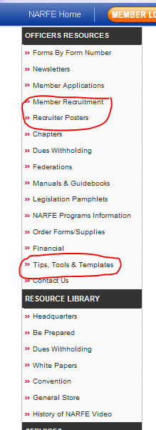
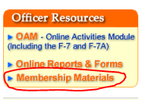
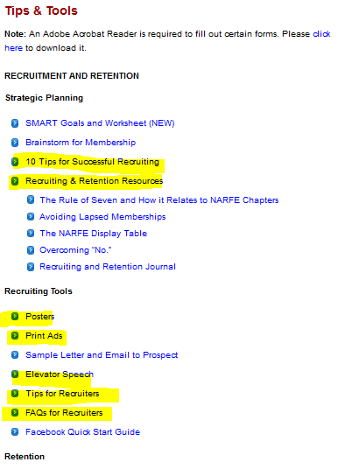
Notes:
NARFE has resources available to help recruiters. Look under “Officer Resources” at narfe.org.

Slide 12
Notes:
Ads and posters available in several standard sizes for immediate download
NARFE makes it easy to print materials for any exhibit or advertising opportunity. You can download pdfs of posters and have them printed and mounted on foam board at Kinko’s or other local source.
The generic “Webinar” poster is new and needs to be displayed at all events.
We encourage you to use the NARFE products rather than create your own. By doing so, we maintain our brand standards and make it easy for the public to associate the NARFE they saw at a health fair with the NARFE information they receive in the mail.
NARFE has created a “print-on demand” webinar flyer that promotes upcoming webinars. We send it out with any requests that we receive for event material. They are not on the current F-18, but will be included in any order that goes out.

Slide 14
Notes:
The Recruiting and Retention Journal is published quarterly. Each issue has a wealth of interesting ideas and suggestions from HQ and the field. The most recent issue and archived issues are available online.
If you don’t get it and want it you can find it on the website. Please click on “Newsletters” under Office Resources in the OAM, or under “What You Can Do Online” on the homepage

Slide 16
NARFE Federal Benefits Institute What is It?
Accurate, Timely, Accessible Federal Benefits Information and Guidance
Delivered in a growing number of formats

Slide 17
NARFE Federal Benefits Institute
New Institute Deputy Director: James Marshall
Fifteen Years providing federal benefits training
Accenture, Government Retirement & Benefits, Inc, National Institute of Transitional Planning, and own firm
On-site and electronic seminars, radio shows, author of benefits related articles

Slide 18
NARFE Federal Benefits Institute
Institute Deputy Director
Senior federal benefits knowledge expert
Direct the transformation of federal benefits knowledge into products and services
Act as primary liaison with the Office of Personnel Management (OPM) and other federal agencies

Slide 19
NARFE Federal Benefits Institute
Institute Deputy Director
Serve as the NARFE federal benefits spokesperson
Direct the timely and accurate response to member and non-member federal benefits inquires
Ensure that new and developing federal benefits issues are understood by NARFE staff and appropriately telegraphed to members.

Slide 20
NARFE Federal Benefits Institute Webinars
Tested in 2015, Rolled Out in 2016, Expanded in 2017
Twenty One Broadcasts To-Date
Webinars are always free to members
All webinars are archived and available on website

Slide 21
NARFE Federal Benefits Institute How Does it Benefit NARFE?
Recruitment
Retention
Non-Dues Revenue
Branding

Slide 22
NARFE Federal Benefits Institute Webinars
To date:
21,917 Registrations
2361 New Members
485 Reinstates
18,967 Current Members
22,685 Archival Views

Slide 23
NARFE Federal Benefits Institute Webinars
Upcoming Webinars:
Oct. 26 -- FEHBP & Medicare -- What's Best for you?
Nov. 30 -- Health Plans: Discover Your BEST Option

