Slide 1
Legislative Update
Region X Conference
October 12, 2017
Molly Checksfield
Grassroots Program Manager

Slide 2
Agenda
NARFE’s Legislative Accomplishments
The 115th Congress (2017-18)
NARFE’s Legislative Priorities
Grassroots Engagement
NARFE-PAC
Questions

Slide 3
Recent Legislative Accomplishments
Federal retirees have not paid for deficit reduction
Prevention of 52% increase in Medicare Part B premiums in 2016
Two-year budget deal did not impact Feds

Slide 4
Recent Legislative Accomplishments
Flawed postal bills have not passed
Extended identity theft protection for those impacted by OPM data breaches
Provided substantive reforms to FLTCIP

Slide 5
The 115th Congress
Administration proposed reorg and downsizing of workforce
Administration proposed severe cuts to federal benefits
Stakes are higher
Maintaining current benefits should be considered a victory!

Slide 6
The 115th Congress – Threats
Trump FY18 Budget - $149 Billion
Eliminate COLAs for FERS retirees
Reduce COLAs by 0.5 percent for CSRS retirees

Slide 7
The 115th Congress – Threats
Trump FY18 Budget - $149 Billion
Increase retirement contributions for FERS by 1% per year for 6 years
Eliminate the FERS annuity supplement
High-3 to high-5 for future retirees

Slide 8
The 115th Congress – Threats
Other Threats
Turning FEHBP into a voucher program
Decreasing the rate of return on the TSP’s G Fund

Slide 9
115th Congress – FY18 Budget
Short-term funding measure signed into law
Funds government with a CR until December 8
$15.25 billion in Hurricane Harvey aid
Extends the debt ceiling deadline

Slide 10
Understanding the Budget Process
Budget Process Will Be Key Driver of Threats to Federal Benefits
Dual track budget process
Likely Bipartisan Agreement Setting FY18 and FY1 Spending Levels
FY18 Reconciliation Tied to Tax Reform
Cuts could appear in both budgets!

Slide 11
Understanding the Budget Process
FY18 Budget Reconciliation: Tax Reform
House budget includes $32 billion in “reconciliation instructions” to OGR
Senate budget does not contain reconciliation
Joint budget agreement must be negotiated
Tax reform represents the biggest threat to federal benefits!

Slide 12
How Serious are the Threats?
Proposals are not new
NARFE has been successful in preventing previous attacks
Top congressional priorities:
Increase in retirement contributions
TSP G Fund change
NARFE is fighting for you!

Slide 13
NARFE Legislative Priorities
Postal Reform Act of 2017, H.R. 756
NARFE opposes
Mandatory Medicare enrollment for current and future postal retirees
Precedent setting:
Breaks a promise
Changes benefits in retirement
Removes choice previously enjoyed

Slide 14
NARFE Legislative Priorities
TSP Modernization Act of 2017
Expands and creates more flexible withdrawal options
Should reduce full transfers out of the TSP
Creates more options for participants
Approved by the House

Slide 15
Grassroots Engagement
Why is Grassroots Important?
NARFE members are their own best advocates
Grassroots efforts are critical to the success of NARFE
Constituent voices resonate with Congress
Congress can change your benefits AT ANY TIME

Slide 16
Grassroots Engagement
Make Your Voice Heard
Call and write your members of Congress!
Share tweets and Facebook posts
Stay Informed
Keep up-to-date with NARFE legislative communications
Coordinate Action
With your fellow NARFE members
Silence = Acceptance

Slide 17
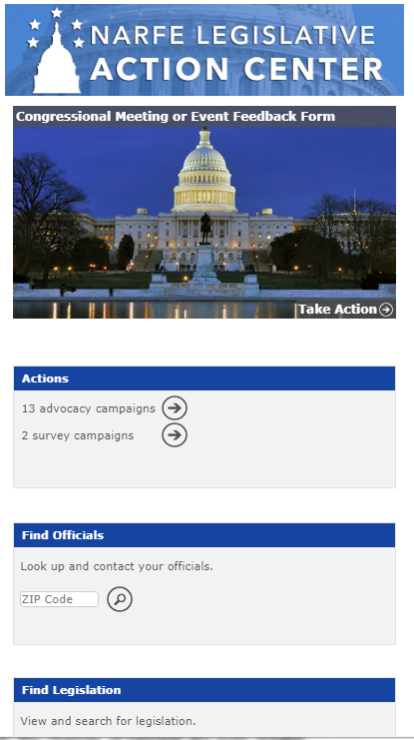
Grassroots Engagement
NARFE’s Legislative Action Center
Send messages to Congress
Review & track legislation
Report your meetings & events

Slide 18
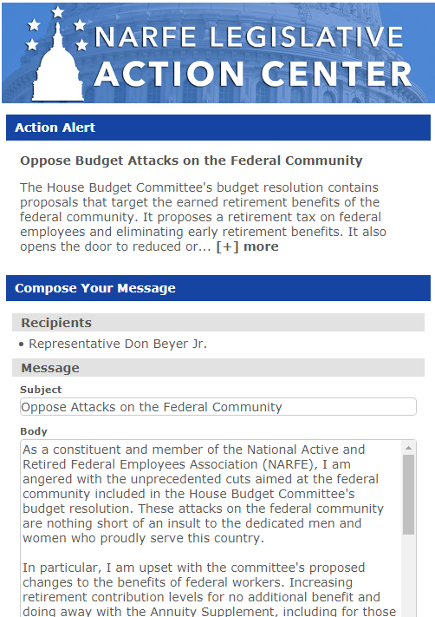
Grassroots Engagement
NARFE’s Legislative Action Center
Send messages to Congress
Read explanation of the bill
Customize your message
Press send!

Slide 19
NARFE-PAC
What is NARFE-PAC?
NARFE’s political action committee (PAC), the political arm of NARFE
Why does NARFE have a PAC?
Access to information
3rd leg of advocacy stool
Keeps NARFE relevant
Builds and strengthens relationships
Supports those who support us

Slide 20
NARFE-PAC
What is NARFE-PAC not?
NOT partisan
NOT used to elect president
NOT a connected fund of NARFE

Slide 21
NARFE-PAC
What is NARFE-PAC not?
General funds
Membership dues
Notecard campaigns
Calendar campaigns

Slide 22
NARFE-PAC
Factors Considered
Support of NARFE issues
Federation recommendation
Influence of legislator
Competitiveness of race
Overall NARFE-PAC budget

Slide 23
NARFE-PAC 2015-16 Election Cycle
Goals
Raise $1 million
Increase monthly giving program (sustainers) by 25%, 50%, 100%
Results
$1.45 million raised!
$671,500 to candidates ($811,500 for political purposes)!
Disburse $525,000 to candidates
Send NARFE members to 30 local fundraisers
65 local fundraisers attended!
126% increase in sustainers!

Slide 24
NARFE-PAC
2017-2018 Goals
Raise $1.5 million
Disburse $1 million for political purposes
Send NARFE members to 100 local fundraisers
Increase Sustainers by 50%

Slide 25
NARFE-PAC
Sustainer: monthly credit card contribution of $10+
Gold: $250+
Silver: $100-249
Bronze: $50-99
Basic: $25-49

Slide 26
Questions?
NARFE Legislative Department
703-838-7760, ext. 201
leg@narfe.org

