Slide 1
Standby for your call for Chapter Management!

Slide 2
Where Is Your Meeting Headed?
Setting Your Chapter Meeting On Fire!

Slide 3
Welcome! Here is what we are going to cover
Looking for Champions
Presiding Over a Successful Chapter
Six Things That Leak in Your Leadership
How to Protect the Relationship
Closing Remarks - -
Setting Your Chapter on Fire!

Slide 4
Setting your Chapter Meeting on Fire! Looking For Champions
You’re not Kevin Costner and this isn’t “Field of Dreams.”
Giving you some creative ground to build on, some things to keep in mind when the going gets tough.
Salute for choosing to share what you know, what you hope for, what you can see ahead of us - - - with other federal champions.

Slide 5
Setting your Chapter Meeting on Fire! Presiding Over A Successful Chapter
It is a People Problem, NOT a Planning Problem

Slide 6
Setting your Chapter Meeting on Fire! Presiding Over A Successful Chapter
It is a People Problem, NOT a Planning Problem

Slide 7
The steps from KNOWING to DOING…..
DOING
T
N
E
M
T
I
M
M
O
C
KNOWING

Slide 8
Setting your Chapter Meeting on Fire! Presiding Over A Successful Chapter
So let’s take a hard, honest look at what will move us forward.
Who are the High Impact People?
Help them Sharpen Their Focus
Coaching Sessions Build Cohesion
Fire Up Relationships That Will Shrug Off Problems
If you can answer yes to these questions, your Chapter has the opportunity for a dynamic future before it.

Slide 9
Chapter Goals are key to Chapter Survival!

Slide 10
Setting your Chapter Meeting on Fire! Presiding Over A Successful Chapter
Help them Sharpen Their Focus
One of the things that makes this process successful is it simplicity.

Slide 11
Setting your Chapter Meeting on Fire! Presiding Over A Successful Chapter
Fire Up Relationships That Will Shrug Off Problems
“Together We Can Move NARFE Forward”

Slide 12
Protect Your Chapter Relationships
Trust Their Intentions
Know The Difference Between Sliding and Jumping
Solve It With Them
Everyone Wants to Win

Slide 13
Protect Your Chapter Relationships
Trust Their Intentions
Protect the Relationships around your by assuming the best in people and trusting that their intentions are good.

Slide 14
Protect Your Chapter Relationships
Know The Difference Between Sliding and Jumping
Jumping Ship is when you have intentionally decided you are no longer content in your current role. Know the difference between sliding and jumping, because it is often an abrasive element within the chapter or a team of people.

Slide 15
Protect Your Chapter Relationships
Solve It With Them
While it rarely works if we attempt to solve other people's problems for them, what does work is to walk with them through the process of addressing the problems and considering solutions. Concentrate on being a good listener and supporter.

Slide 16
Protect Your Chapter Relationships
Everyone Wants to Win
Where goals are lacking.
Where talents are lacking.
Finally, whether your serve as a leader or a member, always be a cheerleader. There is organizational strength and success in winning.

Slide 17
Six Things That Leak in Your Leadership
Vision Leaks
Attitude Leaks
Nearness Leaks
Newness Leaks
Discipline Leaks
Gratefulness Leaks

Slide 18
Six Things That Leak in Your Leadership
Vision Leaks
This is the axiom made popular by Bill Hybels. No matter how sharp and/or passionate we are, no matter your initial level of buy-in . . . . over time vision will leak. Over time we move from, “I know why we are doing this” to “Why does this matter?” Find ways to remind yourself of the vision - - - the hope of a better future that fuels your for today. Keep your eyes on the prize.

Slide 19
Six Things That Leak in Your Leadership
Attitude Leaks
Have you ever noticed over time a positive attitude can slowly descend into a negative attitude? For better or worse the attitude you have will leak out of the people around you. Let the attitude which leaks out of you be and attitude you want others to carry on.

Slide 20
Six Things That Leak in Your Leadership
Nearness Leaks
Relationships are dynamic, always experiencing a move towards closer together or drifting apart. The nearness you have today will leak over time. Of you want to continue experiencing nearness - - - to your God, to family, friends or coworkers - - - then you must be intentional about consistently investing in relationships around you.

Slide 21
Six Things That Leak in Your Leadership
Newness Leaks
Planners and organizers talk about the A-zone and B-zone in life. The A-zone is when everything is new and exciting. The B-zone is where everything is difficult and draining. The exciting feel of “new” will leak. Find a way to make your grass greener instead of looking for greener grass in a new location.

Slide 22
Six Things That Leak in Your Leadership
Discipline Leaks
New Years’ resolutions are a great example of the idea that discipline leaks. Burger joints are slow and gyms are busy during the first 30-60 days of the year. However, the intentionality and focus we have when starting something eventually runs low. Consistent discipline over time requires consistent intentionality right now.

Slide 23
Six Things That Leak in Your Leadership
Gratefulness Leaks
Time has a way of allowing gratitude to erode. Just because you have a thankful heart today, appreciating the hard work of you chapter members, their own dedication and positive attitudes, does not mean you will feel grateful about them tomorrow. Deliberately cultivate that countenance of gratitude that informs you feelings instead of bewing informed by your feelings. Don’t let anyone or anything take charge of your happiness, your positivity, your gratefulness. It’s yours. Enjoy it and share it.

Slide 24
Finally, someone In Your Group…..

Slide 25
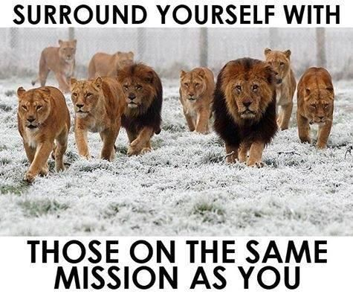
Closing Remarks Setting Your Chapter on Fire!
Keep Your Eyes on the Prize (This is all about protecting what you have earned.)
Someone in your group knows . . .
Someone in your group loves . . .
Someone in your group likes . . .

Slide 26
And always remember……

Slide 27
That’s All Folks!

